Slide 1
Waves
Anatomy of a Wave
Wave Speed
Adding waves
Natural Frequency
Resonance

Slide 2
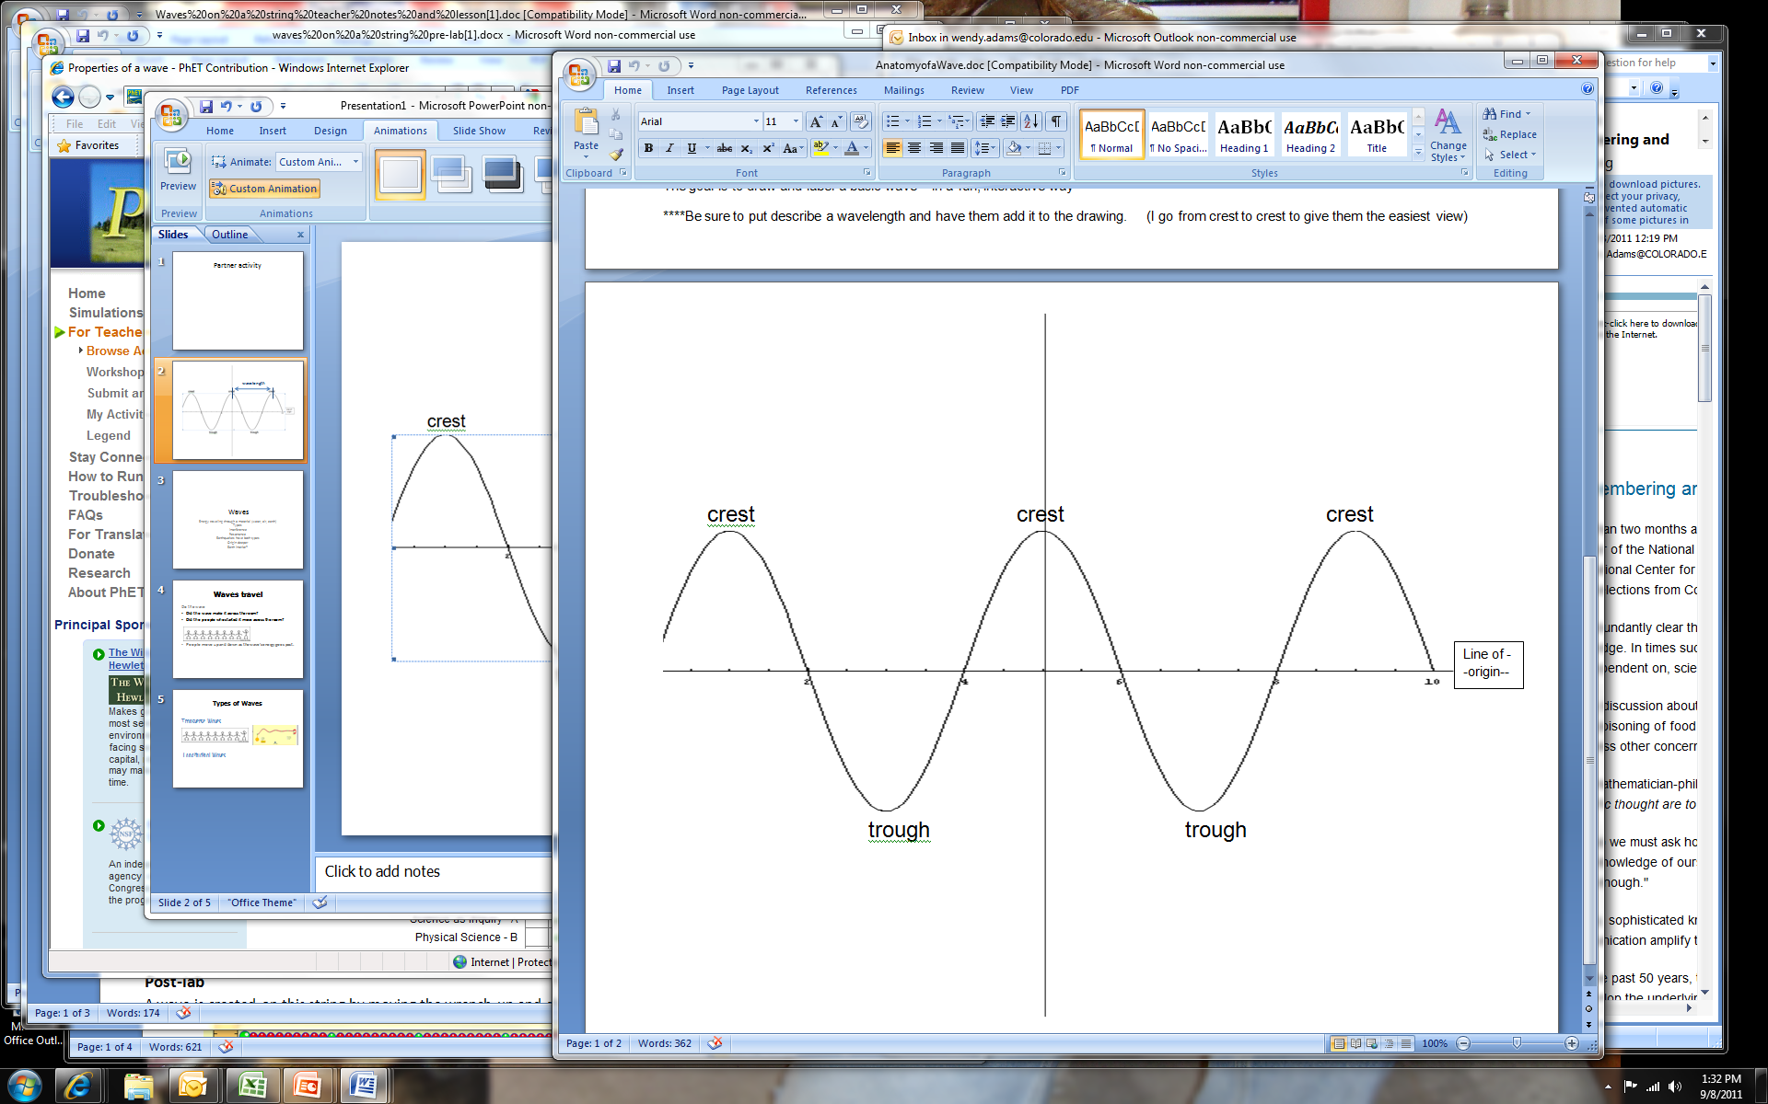
Anatomy of a wave
Notes:
Anatomy of a wave partner activity: Optional One person is a reporter and the other is the artist. The artist tries to draw what the reporter describes. Rules are important but the result is kids learn the parts of a wave and they learn how hard it is to use only a verbal description!

Slide 3
wavelength
wavelength
Wavelength is denoted by λ
Notes:
Define a wavelength as the length between adjacent crests. Show both the first two wavelengths on the slide.

Slide 4
Is this a wavelength (λ)?
A: Yes B: No
Notes:
Ask the class if this is also a wavelength? It is.

Slide 5
Is this a wavelength (λ)?
A: Yes B: No
Notes:
Ask the class if this is a wavelength. It is actually 2 wavelengths.

Slide 6
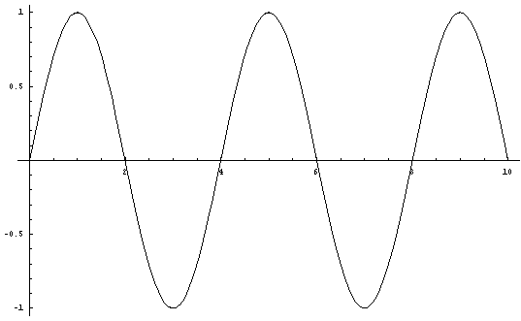
Sailors care about wave height – not amplitude!
Amplitude (A)
  Height/depth of crests/troughs
Frequency (f)
  Rate of the oscillation
Notes:
Define amplitude then show the 1st wave. Ask students to describe what the same wave would look like with a smaller amplitude. If they’ve done the “Wave Basics” homework, they should be able to do this.
Next define frequency. Then show the wave and ask students what it would look like with a smaller frequency.

Slide 7
  Which wave represents a smaller amplitude than the wave shown?
A
B
C
D

Slide 8
  Which wave represents a smaller amplitude than the wave shown?
A
B
C
D

Slide 9
  Which wave represents a smaller frequency than the wave shown?
A
B
C
D

Slide 10
  Which wave represents a smaller frequency than the wave shown?
A
B
C
D

Slide 11
Amplitude (A)
  m (meters)
Frequency (f)
  Number of oscillations per second
  1/s or Hz (hertz)
  Frequency of the above wave is
  ½ Hz
  1 Hz
  2 Hz
  Not enough Information
1 second

Slide 12
Amplitude (A)
  m (meters)
Frequency (f)
  Number of oscillations per second
  1/s or Hz (hertz)
  Frequency of the above wave is
  ½ Hz
  1 Hz
  2 Hz
  Not enough Information
1 second

Slide 13
Amplitude (A)
  m (meters)
Frequency (f)
  Number of oscillations per second
  1/s or Hz (hertz)
Period (T)
  Time for one oscillation
  The period of the above wave is
  ½ s
  1 s
  2 s
  Not enough information
2 Hz

Slide 14
Amplitude (A)
  m (meters)
Frequency (f)
  Number of oscillations per second
  1/s or Hz (hertz)
Period (T)
  Time for one oscillation
  The period of the above wave is
  ½ s
  1 s
  2 s
  Not enough information
2 Hz
0.5 s
1 oscillation (λ)

Slide 15
Wave Speed
Wave on a String Homework:
Does the speed of the wave depend on
Amplitude? A – Yes, B – No
Frequency? A – Yes, B – No
Damping? A – Yes, B – No
Tension? A – Yes, B – No

Slide 16
Imagine a concert
What if wave speed depended on frequency?
  high notes would arrive before low notes
  or vice versa
What if wave speed depended on amplitude?
  louder notes would arrive before quieter notes
  or vice versa
What if wave speed depended on tension?
  That’s how you tune stringed instruments

Slide 17
Wave Speed
Wave on a String Homework:
Does the speed of the wave depend on
Amplitude? A – Yes, B – No
Frequency? A – Yes, B – No
Damping? A – Yes, B – No
Tension? A – Yes, B – No
Have to change the characteristics of the string

Slide 18
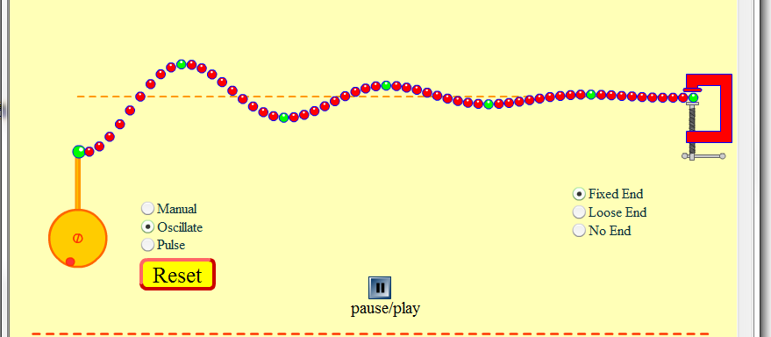
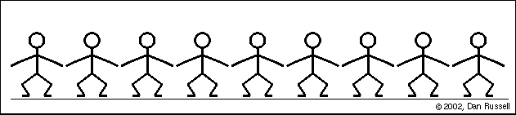
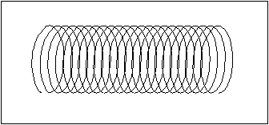
Types of Waves
Transverse Waves
Longitudinal Waves
Transverse, Longitudinal, and Periodic Waves
Notes:
The link at the bottom is a site that has very nice animations. However, it requires Apple Quicktime to run. These animations are simpler and easier to grasp than a slinky wave so I show the slinky after I show the animation.

Slide 19
Source, Receiver & Medium
People Wave
  What is the Source?
  first person
  What is the Receiver?
  last person
  What is the Medium?
  all the people
Notes:
Ask what the source, receiver and medium is for each of these types of waves. You can show the PhET Interactive Simulations “Wave Interference” simulation as a visual of water waves if desired.

Slide 20
Source, Receiver & Medium
Wave on a String
  What is the Source?
  Orange Pump
  What is the Receiver?
  Clamp
  What is the Medium?
  The string of red beads
Notes:
Ask what the source, receiver and medium is for each of these types of waves. You can show the PhET Interactive Simulations “Wave Interference” simulation as a visual of water waves if desired.

Slide 21
Source, Receiver & Medium
Longitudinal slinky wave
  What is the Source?
  start of slinky
  What is the Receiver?
  start of slinky
  What is the Medium?
  The slinky
Notes:
Ask what the source, receiver and medium is for each of these types of waves. You can show the PhET Interactive Simulations “Wave Interference” simulation as a visual of water waves if desired.

Slide 22
How do waves add?
Notes:
Use the PhET Wave on a String simulation: Phet.colorado.edu and asked how the waves add? Example on next slide. It helps to show the Wave on a String simulation first. Show one pulse and how it travels back and forth along the string. Then ask the question on the following slide. You could show both pulses shown on the next slide separately but not together or that will give it away!

Slide 23
Interference of Waves
Superposition Principle
When two or more traveling waves encounter each other while moving through a medium, the resultant wave is found by adding together the displacements of the individual waves point by point.
Constructive Interference
Destructive Interference
Transverse, Longitudinal, and Periodic Waves

Slide 24
Sketch what you think the pattern will look like
Notes:
After students draw their predictions, ask for them to share with the class. Then show the results on the simulation. Click the snapshot to open the sim.
To demonstrate: I used the Pulse feature with Zero damping. First I set the wave characteristics to A = 50, PW = 50, Damping = 0, Tension high, then pulsed and paused quickly. Then I reset the characteristics and sent another pulse. Quickly ,I paused again and used the Step feature for slow motion. You can cycle through the waves interactions many times by stepping.

Slide 25
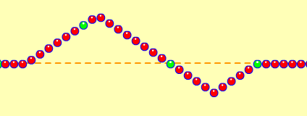
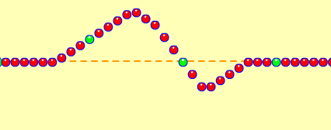
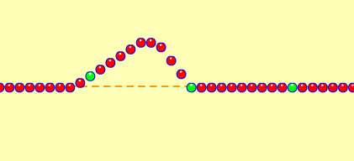
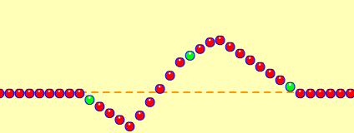
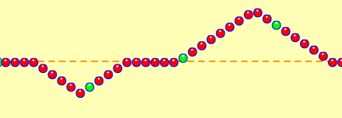
Wave on a String
Notes:
You can see that the lower wave is moving to the left. In shot 3 it’s under the top wave. So the top wave is shorter and the lower wave isn’t showing. When you add them up the top wave plus the negative bottom wave, you get a smaller but still positive number. On shot 4 you can see the lower wave emerge on the left and the top wave is bigger again. Finally shot 5 they are separate again and no different than they were to start with.

Slide 26
Natural Frequency
The frequency at which an object likes to vibrate

Slide 27
Resonance
When one object is vibrating and it is put in contact with another object, if the frequency of the first object is at the natural frequency for the second object, the second object will start vibrating vigorously at its natural frequency.
(pasta demo is an nice clean example of resonance
Or two tuning forks )

Slide 28
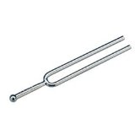
Tuning Fork example
If one tuning fork causes another to resonate,
A. both forks must be the same frequency
B. The forks can be any frequencies
C. The forks have to be the same note.

Slide 29
Tuning Fork example
If one tuning fork causes another to resonate,
A. both forks must be the same frequency
B. The forks can be any frequencies
C. The forks have to be the same note.

Slide 30
Resonance
When one object is vibrating and it is put in contact with another object, if the frequency of the first object is at the natural frequency for the second object, the second object will start vibrating vigorously at its natural frequency.
(pasta demo is an nice clean example of resonance
Or two tuning forks of the same frequency)

Slide 31
Tuning Fork example
When one object is vibrating and it is put in
contact with another object…
If the vibrating tuning fork #1 is held near but not touching the quiet fork #2 and causes fork #2 to begin vibrating,
Fork #1 is resonating with Fork #2
Technically #1 resonates with the air which in turn resonates with tuning fork #2.
The tuning forks must be in contact for one to cause the other to vibrate.
Other
Notes:
2013 ran out of time here

Slide 32
Tuning Fork example
When one object is vibrating and it is put in
contact with another object…
If the vibrating tuning fork #1 is held near but not touching the quiet fork #2 and causes fork #2 to begin vibrating,
Fork #1 is resonating with Fork #2
Technically #1 resonates with the air which in turn resonates with tuning fork #2.
The tuning forks must be in contact for one to cause the other to vibrate.
Other

Slide 33
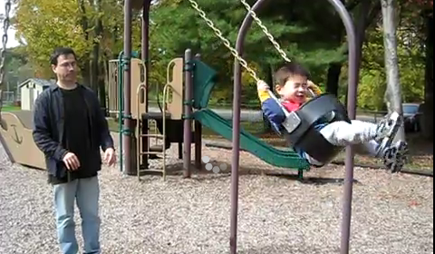
Resonance
Swinging
http://www.youtube.com/watch?v=I4FPK1oKddQ
In terms of energy, generate an explanation of why Dad’s timing has to be just right for the Amplitude to increase.
Notes:
Watch the swing example and explain how your push has to be just right. If it is, each time you push it adds to how high the person is going. If you try to push with different timing than the swings Natural frequency, it just doesn’t work!
Show the pasta raisin demo.

Slide 34
Resonance
Swinging
http://www.youtube.com/watch?v=I4FPK1oKddQ
The swing has a natural frequency that is determined by its length. If the swing is given a small push at the right time in
each cycle, its amplitude gradually increases. This is an example of resonance. The swing receives a small amount of energy during each push, but provided this amount is larger than the energy lost during each cycle (due to friction and air drag), the amplitude of swing increases.
Notes:
Watch the swing example and explain how your push has to be just right. If it is, each time you push it adds to how high the person is going. If you try to push with different timing than the swings Natural frequency, it just doesn’t work!
Show the pasta raisin demo.

Slide 35
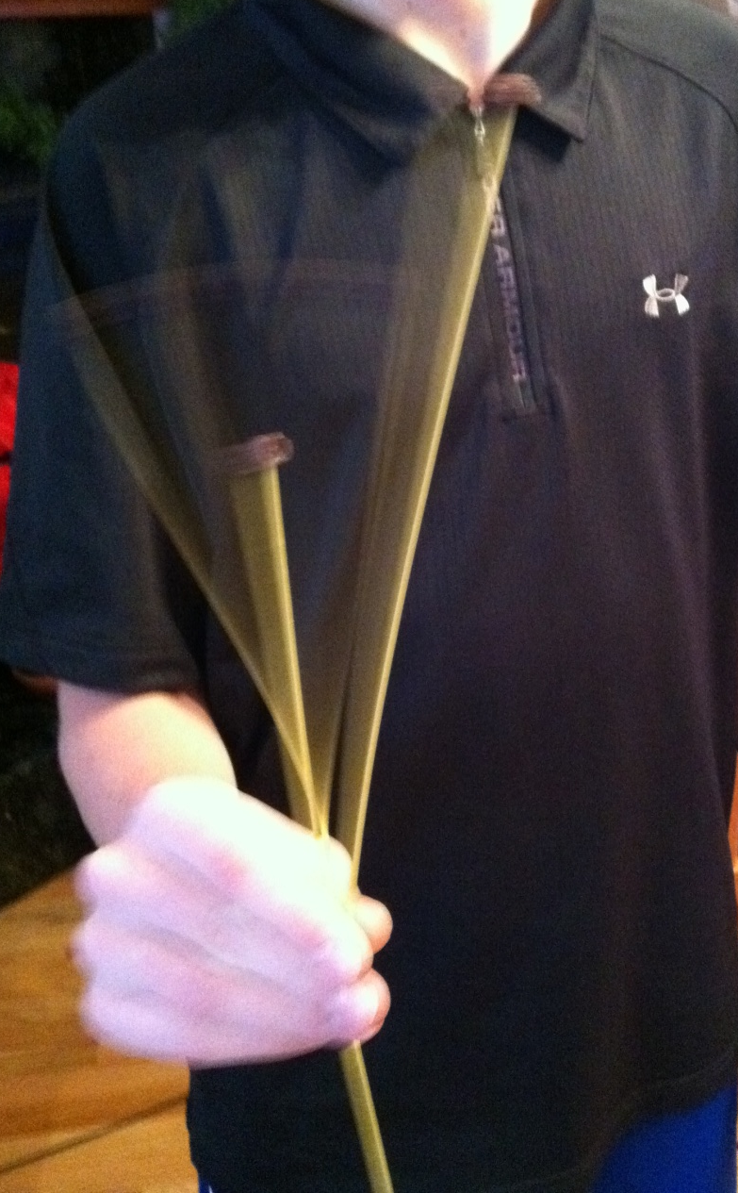
Resonance
Pasta/raisin demonstration
When a driving frequency causes an object to vibrate at its natural frequency.
Notes:
Show the pasta raisin demo. In this picture can you see the middle pasta and how fast it is moving?!

Slide 36
Resonance
When a driving frequency causes an object to vibrate at its natural frequency.
Wave on a String (A=3, f=50, Damp = 0, Tension = high)
Notes:
Use the settings given above to show resonance with the Wave on a String simulation. It’s really NEAT.

Slide 37
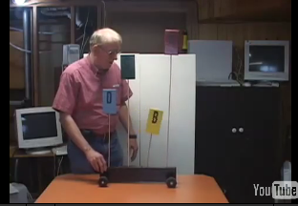
Resonance
When a driving frequency causes an object to vibrate at its natural frequency.
Tall vs. Short Building damage
Notes:
This is a very clear video of resonance. It’s designed to demonstrate earthquake damage but works beautifully for resonance in general. It shows different height objects resonating at different frequencies. I stop the video at the points where the speaker says he asks his students to predict, then I ask my students to predict.

