Slide 1
Doppler Shift
+ observer moving towards, - observer moving away,
source moving towards, + source moving away.
v = speed of sound
v_{o} = observer speed
v_{s} = source speed

Slide 2
A car is approaching an observer at 30 m/s and sounds its horn at 500 Hz. What frequency does the observer hear?
548 Hz

Slide 3
If the observer is driving at 30 m/s towards a stationary car which is sounding its horn, what frequency will the moving car hear?
544 Hz

Slide 4
Sonic Boom
Have you personally heard a sonic boom?
A. Yes
B. I think so
D. No

Slide 5
Sonic Boom
Describe to your neighbor(s)
1. What it sounded like
2. What you think causes a sonic boom

Slide 6
Sonic Boom
Mach Number:
Speed / Speed of Sound
Mach 1: v = 343 m/s
Mach 2: v = 686 m/s
What would Mach 0.5 be?
~170 m/s

Slide 7
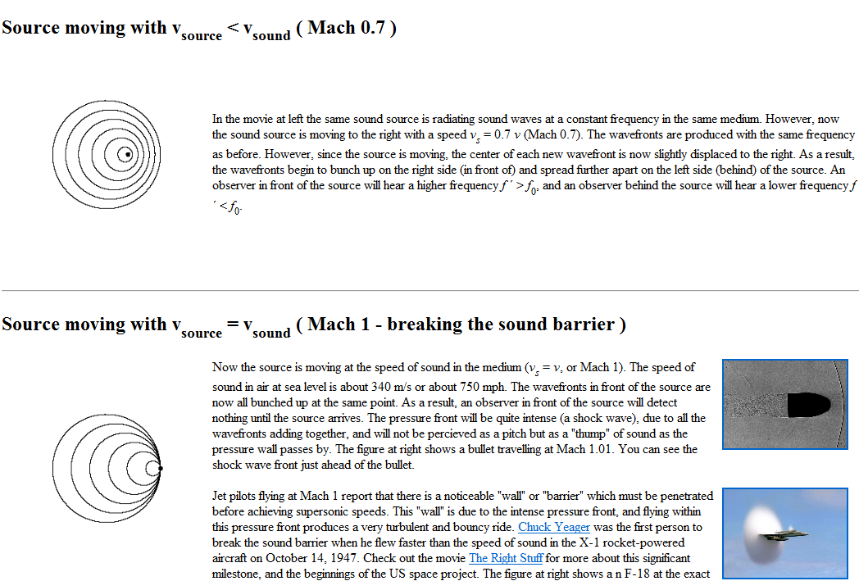
Sonic Boom

Slide 8
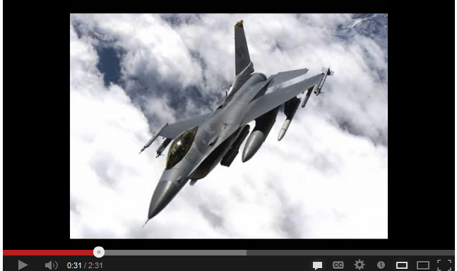
Sonic Boom

Slide 9
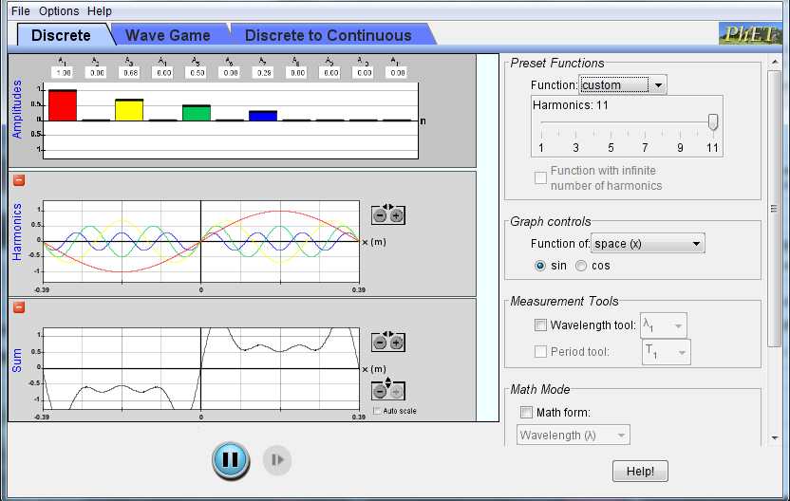
Harmonics and perception

Slide 10
Standing Waves
Superposition Creates Standing Waves
Two sinusoidal waves traveling in opposite directions add to create a standing wave.

Slide 11
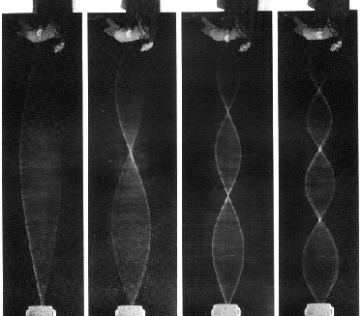
The Fundamental – the longest wavelength that will fit on a string.
Also known as the 1st harmonic
2nd Harmonic

Slide 12
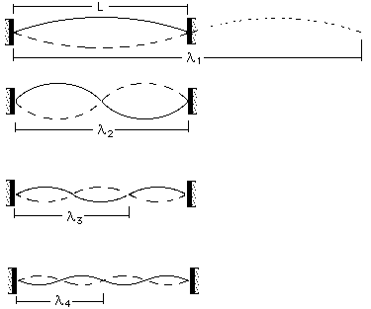
f = v/λ
1st harmonic λ₁ = 2L
2nd harmonic λ₂ = L
3rd harmonic λ₃ = 2/3L
4th harmonic λ₄ = 1/2L
Nth harmonic λ_{n} = 2L/n
so f = nv/(2L)

Slide 13
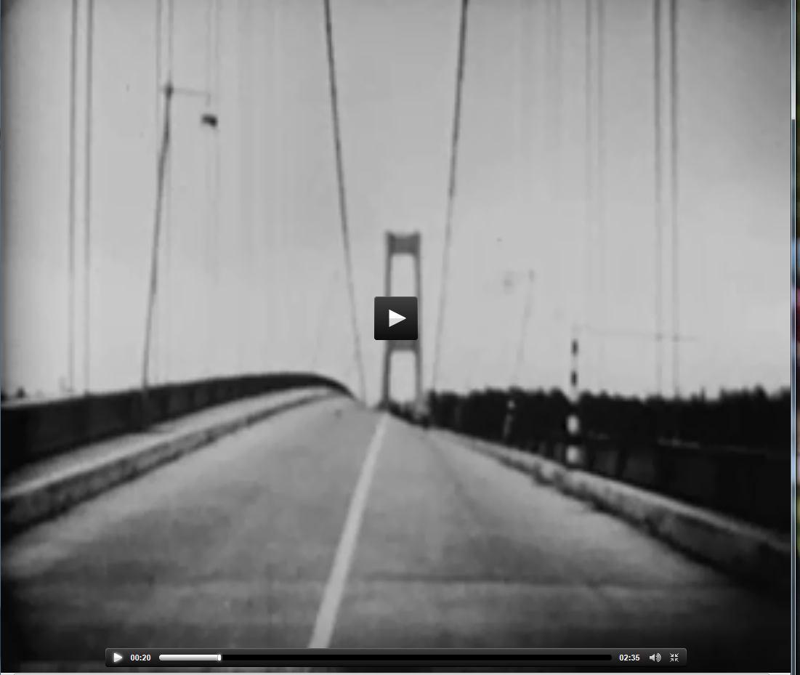
Tacoma Narrows Bridge

