Slide 1
Balloon Boy Lab
Up, Up, and Away

Slide 2
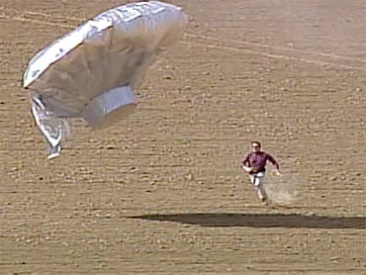
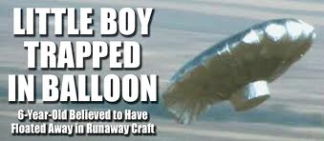
Balloon Boy Lab
America stood in horror watching on the news a large helium Mylar balloon believed to be carrying a young boy traveling across the state of Colorado. This helium balloon was thought to have reached an altitude of 10,000 feet. As it slowly descended to the ground many different state and county agencies were anxious to help rescue this boy.

Slide 3
Balloon Boy Lab

Slide 4
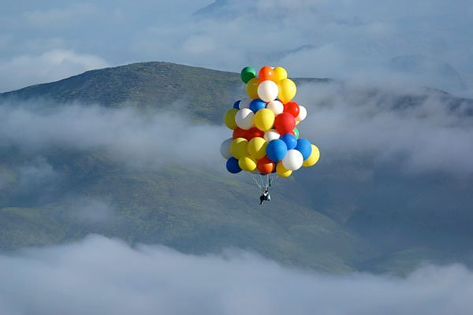
Balloon Boy Lab
Using a helium filled balloon, attach enough paper clips to get the balloon to be neutrally buoyant. Then see how many balloons it would take to keep aloft a six-year-old boy weighing around 50 lbs. (22.7 kg.)

Slide 5
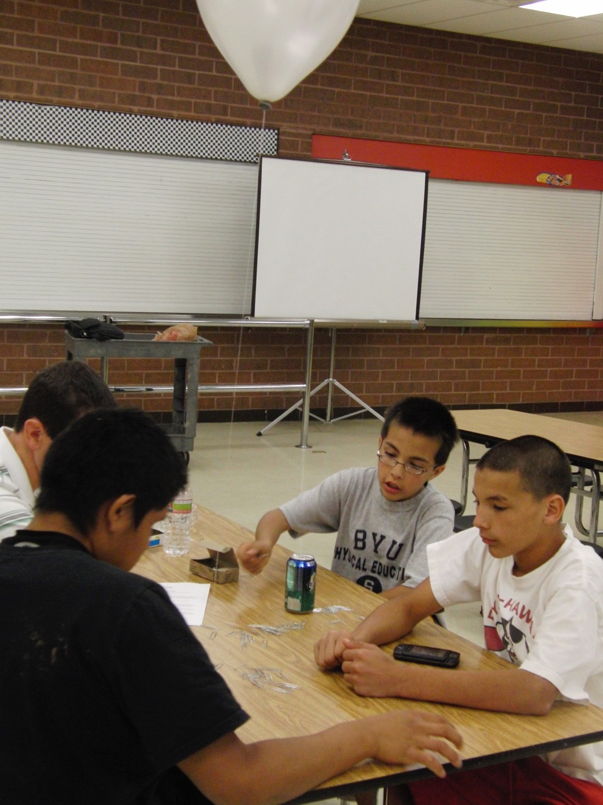
Balloon Boy Lab
MATERIALS
Helium Filled Mylar Balloon
Triple beam balance
Paper Clips
String or Thread
Scissors
Meter stick, measuring tape

Slide 6
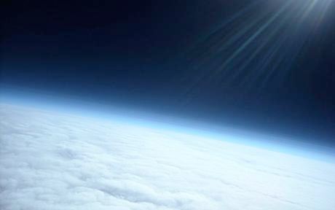
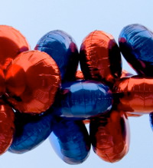
Balloon Boy Lab
PROCEDURES
1. Find the volume of your helium balloon in cm³.
2. Take the helium filled balloon and attach enough paper clips to the end of it to achieve neutral buoyancy. Find the mass of the paper clips.

Slide 7
Balloon Boy Lab
3. Calculate the buoyant force of the helium filled balloon. Calculate how many balloons it would take to lift a 22.7 kg. Boy.
4. Calculate how many balloons it would take to keep you aloft.
This is “Lawnchair Larry” July 2, 1983

Slide 8
Balloon Boy Lab

Slide 9
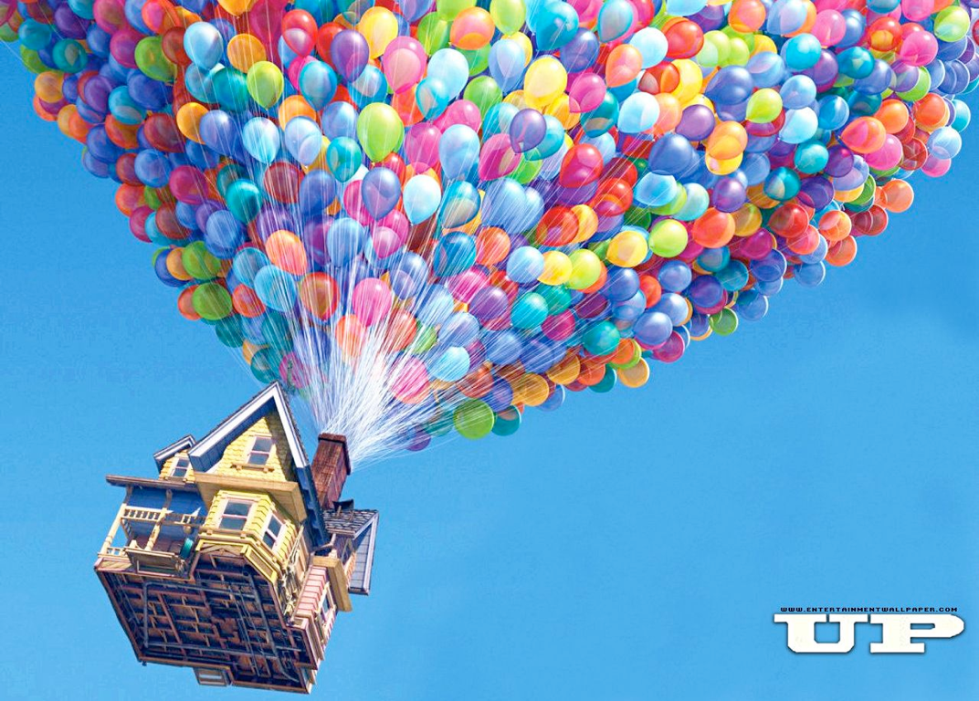
Now calculate the volume of a weather balloon that has a diameter of 8 feet. How many balloon would it take to lift a small house that weighs 454.5 kg.

Slide 10
Balloon Boy Lab

