Slide 1
Magnetic Resonance Imaging (MRI)
Ashley Summerton, Ariel Rivera, Mallory Vanhout, Josh Martinez, Cody VanDoren, Mark Anderson, Casey Coy and Erin Wilkinson

Slide 2
About MRI’s
Uses a magnetic field and pulses of radio wave energy to make pictures of organs and structures inside the body.
MRI’s often show different angles and parts of the body that things like CAT Scans, and X-rays don’t.
The area of the body being studied is placed inside a special machine that contains a strong magnet.
Pictures from an MRI scan are digital images that can be saved and stored on a computer for more study.

Slide 3
Background Biology Information
The body is largely composed of water molecules which each contain two hydrogen nuclei or protons
Magnetic moments of these protons align with the direction of the field when the person enters the chamber.
A radio frequency electromagnetic field is then briefly turned on, causing the protons to alter their magnetization alignment relative to the field

Slide 4
When this field is turned off the protons return to the original magnetization alignment
These magnetization alignment changes create a signal which can be detected by the scanner
The frequency at which the protons resonate depends on the strength of the magnetic field

Slide 5
The position of protons in the body can be determined by applying additional magnetic fields during the scan which allows an image of the body to be built up
These are created by turning gradient coils on and off which creates the knocking sounds heard during an MRI scan

Slide 6
How Does an MRI Work?

Slide 7
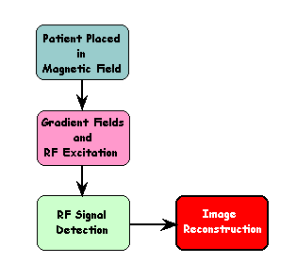
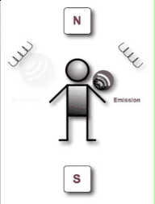
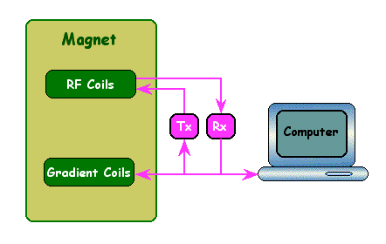
The physics behind MRI
http://phet.colorado.edu/en/simulation/mri

Slide 8
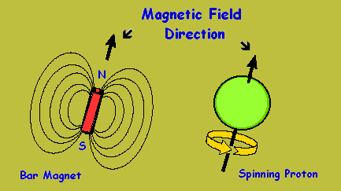
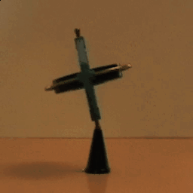
Besides having an electrical charge, protons also spin on its axis.
Since this spinning constitutes a moving electrical charge (i.e. rotating around a central axis), a magnetic field is generated, similar to that generated by a bar magnet.
This spinning magnet aligns itself with any external magnetic field of the MRI machine, as shown.

Slide 9
“Resonance” Frequency
Radio wave has an exact amount of energy needed to flip the spin of the proton
This energy is reflected by its frequency
f=Δ E/h

Slide 10
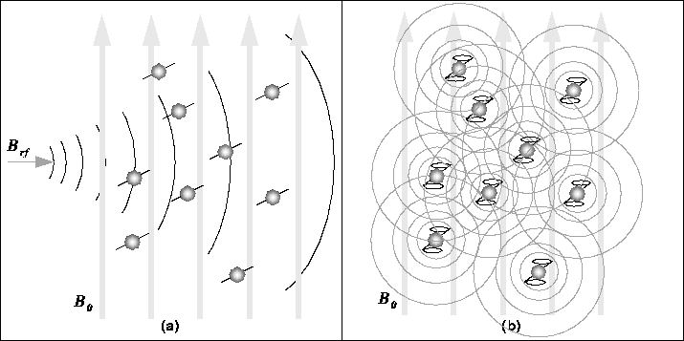
The RF signal has a frequency equal to the unique resonant frequency of the nuclei which will excite the protons and causes a pulse as seen in the image below. After the pulse stops, the nuclei will return to equilibrium. During this realignment, the nuclei lose energy and RF signal, which is then picked up by the machine and translated by a computer and put together as an image.

Slide 11
Once Absorbed RF Energy is Emitted
Nuclei that have absorbed the radio frequency energy will not remain in their excited state for a long time
They return to their initial state, emitting a radio frequency signal to their surroundings.
These signals are picked up by detectors that are placed all around the body.
The signals are then compiled using Computed Tomography techniques into an image.

Slide 12
How MRI correlates with Physics
http://www.youtube.com/watch?v=9E1GoWhSlho
Source: YouTube

Slide 13
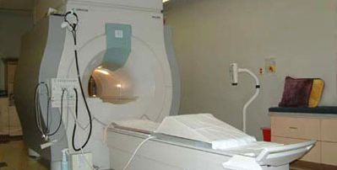
MRI Machine
During an MRI procedure you will lie on your back on a table that is part of the MRI scanner. Your head, chest, and arms may be held with straps to help you stay still. The table will then slide into the round opening of the magnet.

Slide 14
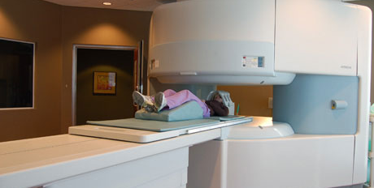
Open MRI Machine
Often used for children and people who are claustrophobic. Not always available. Inside the scanner you will hear a fan and feel air moving. You may also hear tapping or snapping noises as the MRI scans are done. It is very important to stay completely still while the scan is being done.

Slide 15
Why are MRI’s done?
It is used to find problems such as tumors, bleeding, injury, blood vessel diseases, or infection.
MRI’s also may be done to provide more information about a problem seen on an X-ray, ultrasound scan, or CT scan.
Contrast material may be used during MRI to show abnormal tissue more clearly, because the contrast agents alter the relaxation times of atoms within body tissues where they are present after oral or intravenous administration.

Slide 16
Head:
tumors
aneurysm
bleeding in the brain
nerve injury
damage caused by a stroke
optic nerves
Ears
Auditory nerves
Chest:
Heart
Valves
coronary blood vessels
heart or lungs are damaged
breast or lung cancer

Slide 17
Abdomen and pelvis:
Liver
Gallbladder
Pancreas
Kidneys
Bladder
find tumors
Bleeding
Infection
blockage
In women, it can look at the uterus and ovaries.
In men, it looks at the prostate.
Spine:
*MRI can check the discs and nerves of the spine for conditions such as spinal stenosis, disc bulges, and spinal tumors.
Bones and joints:
Arthritis
problems with the temporomandibular joint
bone marrow problems
bone tumors
cartilage problems
torn ligaments or tendons

Slide 19
Sources
http://www.webmd.com/a-to-z-guides/magnetic-resonance-imaging-mri
http://en.wikibooks.org/wiki/Basic_Physics_of_Nuclear_Medicine/MRI_%26_Nuclear_Medicine
http://web2.uwindsor.ca/courses/physics/high_schools/2006/Medical_Imaging/mriphysics1.html

