Slide 1
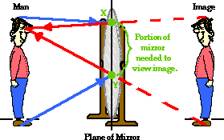
Need a mirror ½ your height to see from head to toe.

Slide 2
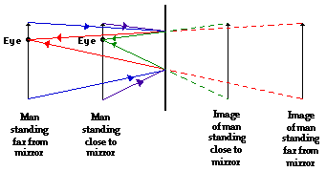
Move back, same amount of mirror

Slide 3
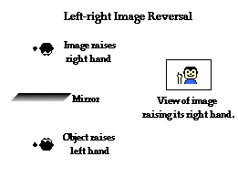

Slide 5
I’m assuming the reflective surface is the front

Slide 6
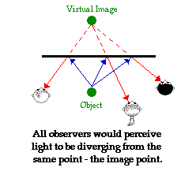

Slide 7
Wave, particle or…
Wave vs. particle on microscopic scale
10 ⁻⁷ meters
Very specialized study to see either
Ray Approximation or Geometric Optics
Meters
Every day experiences

Slide 8
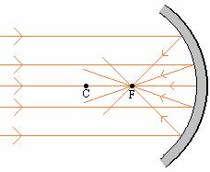
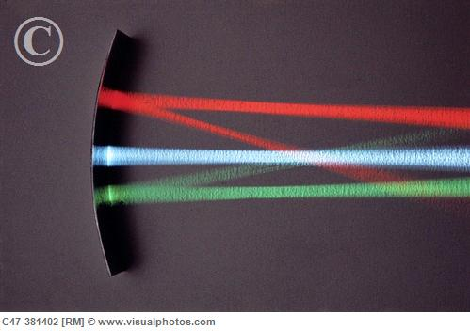
Concave Mirror Converging mirror: light reflects from the inner surface of a spherical mirror

Slide 9
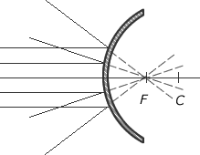
Convex Mirror Diverging mirror: light reflects from the outer surface of a spherical mirror

Slide 10
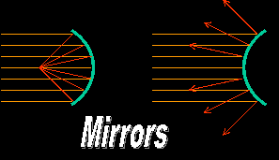
Concave Convex converging Diverging

Slide 11
Concave Convex converging Diverging
C is Center of curvature F is Focal Point

