Slide 1
X-rays

Slide 2
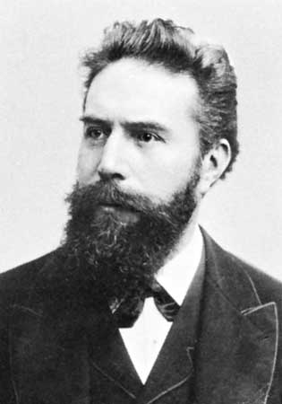
History
Röntgen accidently discovered x-rays in 1896
Could pass through paper and wood but stopped by bone and metal
The first X – Ray was performed on his wife’s hand
The first medical use was less than a month after his paper on the subject and the x-ray radiation is ionizing

Slide 3
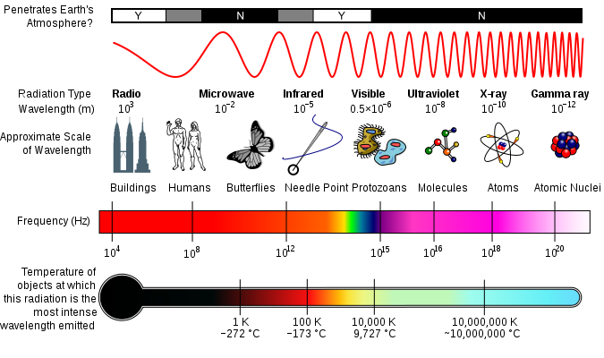
X-ray Basics
Electromagnetic waves, that behave like a particle in a liquid.
High frequency small wavelength (about 0.1 nm).
X-ray on Electromagnetic Scale

Slide 4
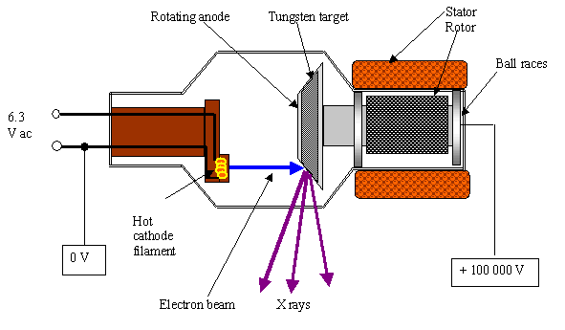
Production of X-rays
Electrons produced by heating a cathode
Electrons accelerated to high speed through a vacuum
Electrons strike a metal target
The kinetic energy of the electron drops and the lost energy transfers into the generation of an X-ray thus using conservation of energy
X-Ray simulation
http://www.youtube.com/watch?v=6BzFmG4RSMI

Slide 5
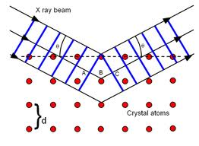
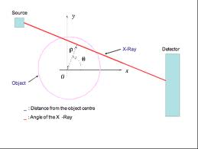
Bragg’s Law
2dsinθ=mλ this is Bragg’s Law. It is used to figure out the planes in the crystal lattice.
λ_{min} =hc/e∆V this equation is used to find the minimum possible wavelength of an x ray.

Slide 6
Radiographic Film
The radiographic film is covered by a filter which reduces the amount of scattered x-rays which can cause a chemical reaction
The film itself is a polyester sheet covered with a silver bromide Ag⁺ Br⁻ emulsion
When ionizing radiation interacts with the emulsion, free electrons may be captured by the silver ion, forming a stable silver atom. This atom comes out of the solution and attaches to the polyester film
When the film is treated the areas exposed to ionizing radiation will appear darker on the film due to the silver atoms

Slide 7
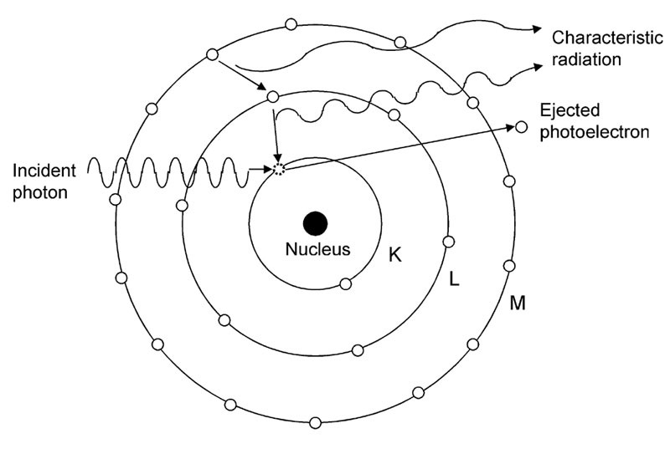
The Photoelectric Effect
X–ray is absorbed in the body the electron jumps out of the atom
This is where the energy of the ejected electrons was proportional to the frequency of the illuminating light
Planck’s idea that electrons vibrate at quantized energy levels (E= 0, hf, 2hf, 3hf etc…)
Einstein: E = hf

Slide 8
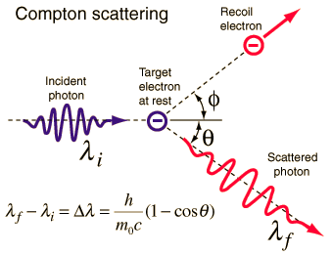
Compton Scattering
Particle Behavior of X-rays
Compton Shift
Obeys laws of conservation of energy and momentum
Change in wavelength results

Slide 9
Compton Shift
Compton Shift
Δλ=λ-λ₀=(h/m_{e}c)(1-cosθ), where:
m_{e} is the mass of an electron
θ is the angle between scattered and incident photon
h/m_{e}c is the Compton wavelength
= 0.00243 nm
Allows the change in wavelength to be calculated

Slide 10
Absorption and Scattering
Bone
Photoelectric effect
Compton Scattering
Tissue
Compton scattering

Slide 11
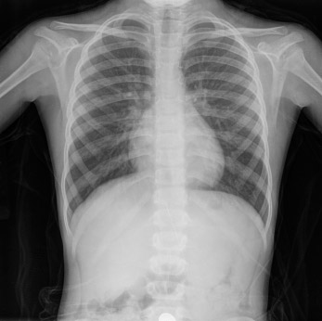
Medical Applications
Produce an image of the underlying structure of the body such as the bone and other tissues.
Dental Examinations
Contrast Media Injection/Ingestion
Iodine or Barium
Absorb X-ray photons
Produce an image—like bone

Slide 12
X-ray
http://www.youtube.com/watch?v=wbbsbE2mQuA&feature=related

Slide 13
Questions?

