Slide 1
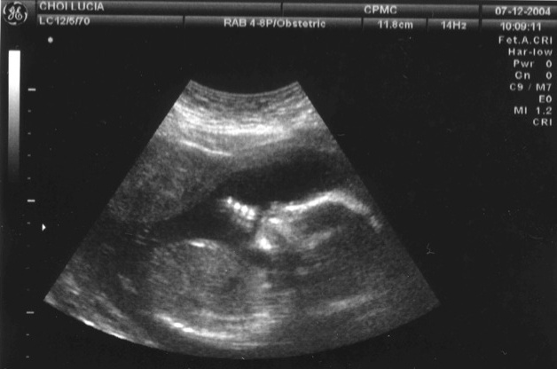
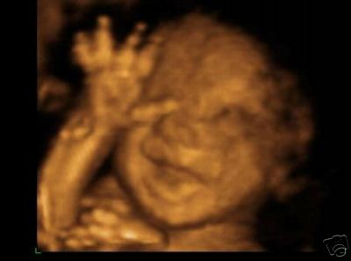
Ultrasound Imaging

Slide 2
Basic Overview
Definition: Noninvasive method of examining the internal condition of an individual using a transmission of high frequency sound waves.
Wavelengths used in Ultrasound imaging:
2MHz to 17 MHz
Hearing range: 20Hz to 20,000Hz

Slide 3
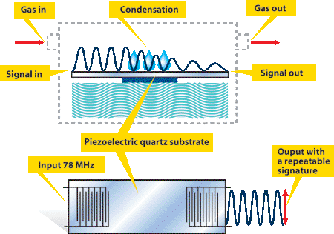
How It Works
Sound made using piezoelectric effect and quartz
Sound bounces off interface while some penetrates further
Refracted
Reflected
Sound picked up
Sound interpreted by computer to find distance

Slide 4
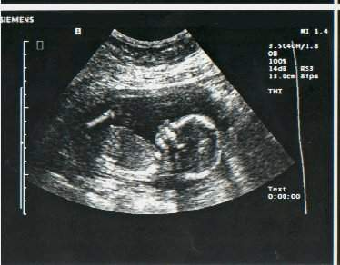
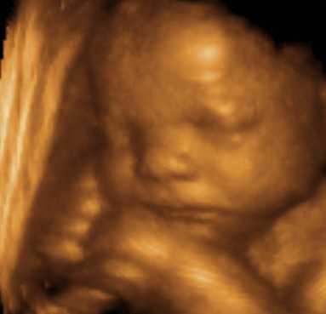
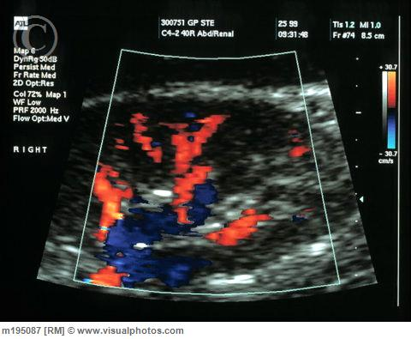
Types of Ultrasound
Basic 2D
Just the reflections are picked up and displayed
3D
Uses 2d as slices and compiles them into a 3d image
Doppler Ultrasound
Used to look at speeds of fluids with Doppler shift

Slide 5
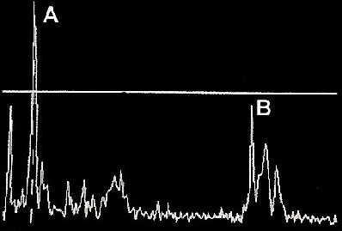
Modes of Ultrasound
Amplitude mode (A-mode)
A single transducer sends a line through the body
Echoes are plotted as a function of depth
There is no exact way to be sure what the echo is reflected off of or what the object looks like.

Slide 6
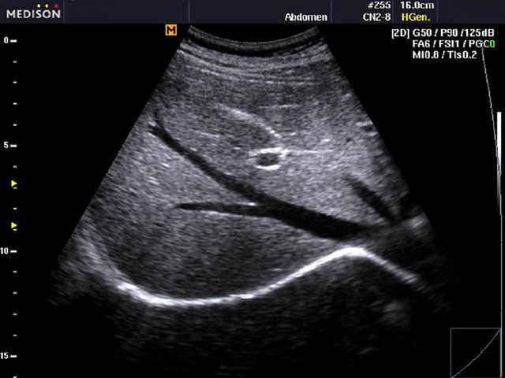
Modes of Ultrasound
Brightness mode (B-mode)
A linear array of transducers scans a plane through a body
Produces a two-dimensional image
Similar to A-mode, adds a sense of direction to the echo
Human liver; B-mode ultrasound

Slide 7
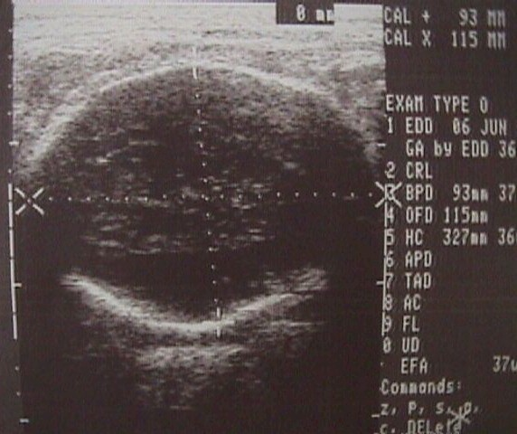
Modes of Ultrasound
B-mode
http://www.brooksidepress.org/Products/Military_OBGYN/Ultrasound/basic_ultrasound.htm

Slide 8
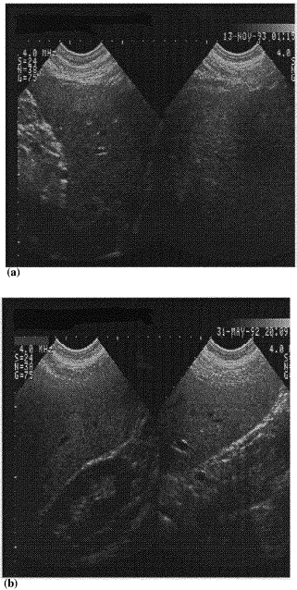
Modes of Ultrasound
Real time (C mode)
Formed in a plane
Data selection from a specific depth line can be used
Transducer scans the area in a spiral, area of 100cm²
Produces a series of still images
Useful when viewing a moving object such as a fetal heart
http://ars.sciencedirect.com/content/image/1-s2.0-S1386505699000106-gr1ab.gif

Slide 9
Modes of Ultrasound
Motion mode (M-mode)
The first ultrasound mode to record and display moving echoes
Transducers create pulses that are emitted quickly
Every pulse is an A-mode or B-mode image that is captured
Eventually it is much like a video being recorded in ultrasound

Slide 10
Doppler Ultrasound
A special kind of ultrasound, images of flow
Blood flowing
Muscle contraction
Employs Doppler measurements to enhance standard ultrasound imaging
“MVC Carotid Ultrasound”. www.mvccardiology.com

Slide 11
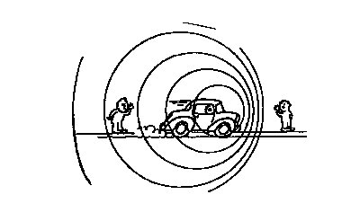
The Doppler Effect
First explained by Christian Doppler in 1842
To explain the shift in wavelength and frequency of waves resulting from the source or receiver moving in relation to one another
f' is the perceived frequency
f₀ is the actual frequency
v_{s} is the relative speed of the source
v_{o} is the speed of the observer
v is the speed of sound in the medium

Slide 12
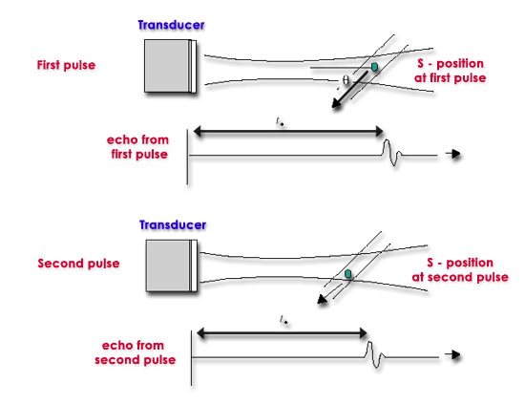
Doppler Ultrasound
Echoes from stationary tissues are the same from pulse to pulse
Echoes from moving tissues exhibit slight differences in time for the signal to be returned to the receiver
These differences can be measured as a direct time difference or in terms of phase shift from which the ‘Doppler frequency’ is obtained
They are then processed to produce either a color flow display or a Doppler sonogram
Doppler in Obstetrics. www.centrus.com/br

Slide 13
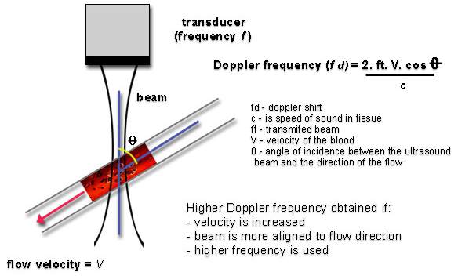
Doppler Ultrasound
The size of the Doppler signal is dependent on:
Velocity of study tissues
Frequency of the ultrasound (sensitivity or better penetration?)
Angle of incidence (as θ decreases, the Doppler ultrasound beam becomes more aligned to the flow direction
Note: if the flow/movement is perpendicular to the ultrasound pulse, no relative motion will be discerned
Doppler in Obstetrics. www.centrus.com/br

Slide 14
Doppler Ultrasound
Applications:
Used to image, monitor, and diagnose
Blood flow through major arteries and veins
Can showed blocked or reduced blood flow in narrowed arteries; stroke risk
Blood clots (thromboses); risk of pulmonary embolism
Pregnancy: blood flow to baby, Rh sensitization
Guide treatments such as laser or radiofrequency ablation of abnormal veins

Slide 15
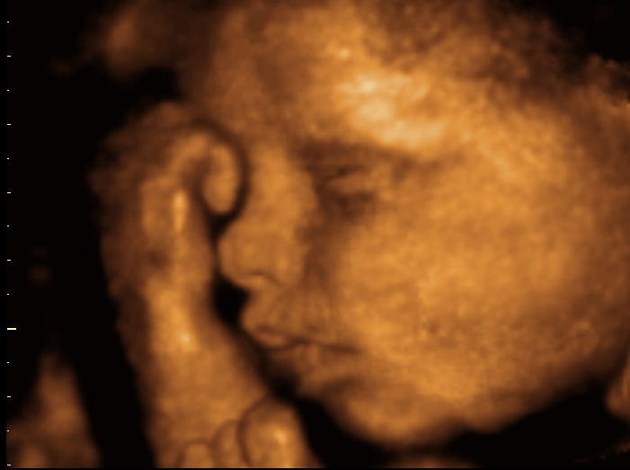
3-D Ultrasounds
Making Waves: the 3D ultrasound pioneer
Within a couple of decades, 3D ultrasound will have totally supplanted the familiar 2D technology.
That's the take of Stephen Smith, professor of biomedical engineering at Duke University (Durham, NC), who, with his colleague, Olaf von Ramm, pioneered the development of clinical 3D ultrasound scanners back in the 1980s.
Since then, Smith and his research group have refined and adapted 3D ultrasound for a whole host of applications, and have market domination firmly in their sights.

Slide 16
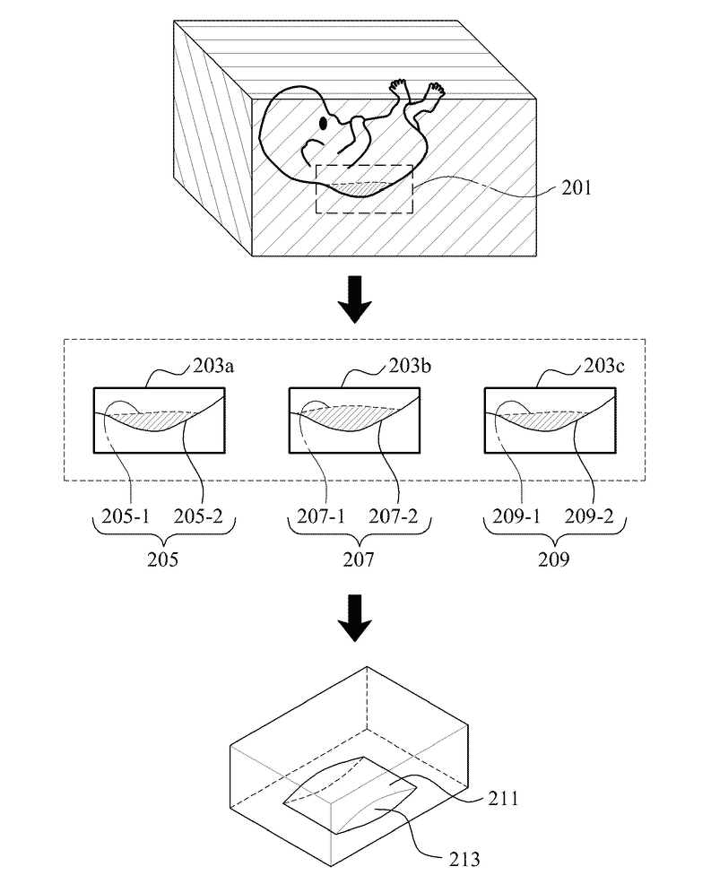
3-D Ultrasounds
How does the technology actually work?
the ultrasound moves beam back and forth in a raster pattern, say in the x and y directions, then the depth into the tissue comprises the third dimension. If you plot the echo strength as a function of x, y and z, you have a 3D image.
3-D Ultrasounds have the same physics as normal 2-D ultrasounds, except for the waves enable you to plot all three X, Y, and Z directions which give you the 3-D image.
This 3-D image has much more detail, and can even take actual size measurements of your internal organs or unborn fetus.
Patentdocs. Patent application publication. Dec 1, 2011. www.faqs.org/patents

Slide 17
3-D Ultrasounds

Slide 18
3-D Ultrasounds
Transducers automatically scan from one side to the other.
Slices are collected and stored as volume of data.
Volume of data manipulated to form desired result.
3-D ultrasounds are being used to help get images of the human heart as well as the human unborn fetus. It can help detect birth defects early on in pregnancy, which helps prepare doctors to treat these conditions at an early stage.

Slide 19
3-D Ultrasounds
Mechanical 3D Transducers
6 to 2 MHz extended operating frequency range
Supports high resolution 2D imaging
high resolution, quantitative, single sweep 3D volume acquisition
4D imaging up to 36 volumes per second
Color Doppler
Field of view: 66 degrees
General purpose abdominal, obstetrical and gynecological applications

Slide 20
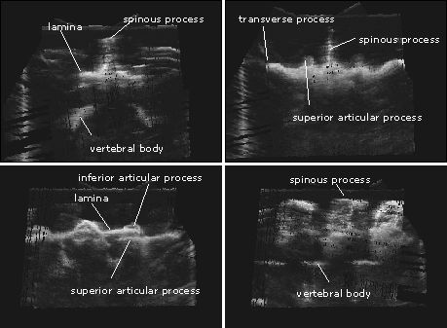
Additional Medical Applications of Ultrasound
Obstetric Imaging
Looking at fetal development
Looks at condition of organs
Can look a bone structure
Very safe
Only known to cause heating problems, most have been resolved

Slide 21
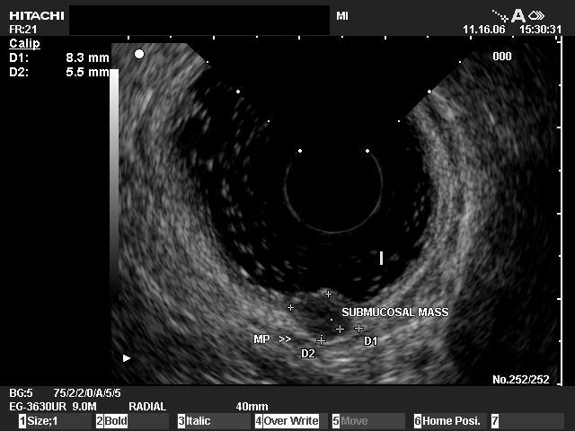
Additional Medical Applications of Ultrasound
Pelvic abnormalities
techniques known as
abdominal (transabdominal) ultrasound,
vaginal (transvaginal or endovaginal) ultrasound in women,
rectal (transrectal) ultrasound in men.
Endoscopic ultrasound of the rectum in a patient with a carcinoid tumor. Gastroenterology Associates. giassociateschicago.com.

Slide 22
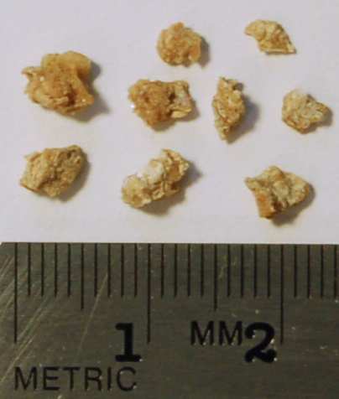
Additional Medical Applications of Ultrasound
Lithotripsy
Focused high-energy ultrasound pulses
break calculi such as kidney stones and gallstones into fragments small enough to be passed from the body without undue difficulty

Slide 23
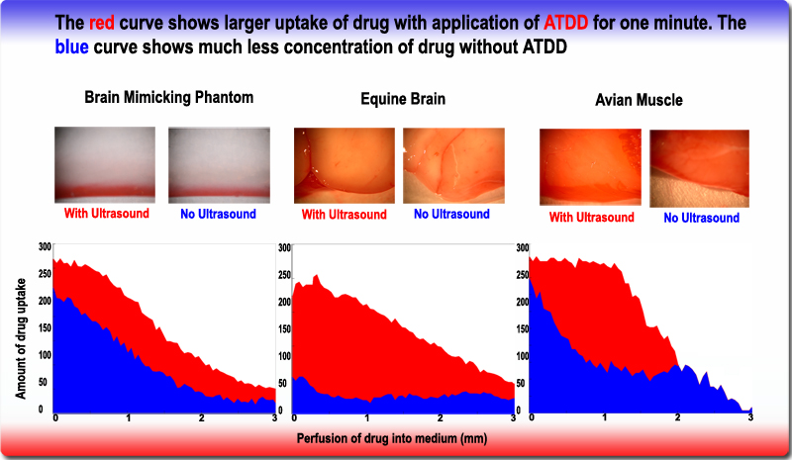
Additional Medical Applications of Ultrasound
Acoustic Targeted Drug Delivery (ATDD)
Delivering chemotherapy to brain cancer cells and various drugs to other tissues
The acoustic energy is focused on the tissue of interest to agitate its matrix and make it more permeable for therapeutic drugs.

Slide 24
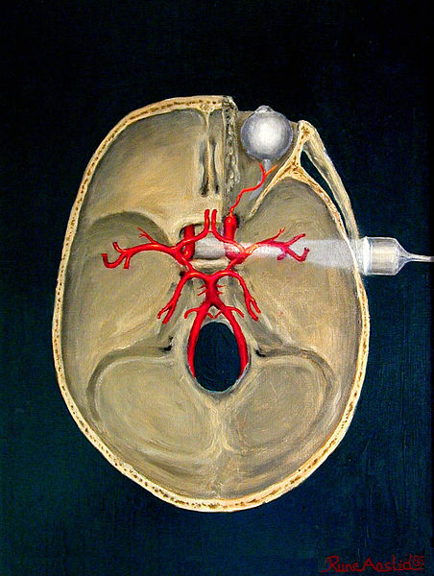
Additional Medical Applications of Ultrasound
Transcranial Doppler Ultrasonography
Ultrasound-Enhanced Systemic Thrombolysis
aimed at residual obstructive intracranial blood flow
help expose thrombi to tissue plasminogen activator or other thrombolytic drugs.
complete recanalization or dramatic clinical recovery can be increased by more than 19%

Slide 25
Medical Limitations
Although ultrasound is a valuable tool, it does have its limitations
Large differences in density of tissues --> greater refraction, less clarity of imaging
Recall Snell’s Law:
Soft tissues
Bone
Gas

Slide 26
Medical Limitations
Attenuation of sound, high frequency is worse
Stokes’ Law of sound attenuation in a Newtonian fluid:
α is attenuation of sound (units: neper(Np)/m)
η is dynamic viscosity of the medium (units: Pa∙s)
ω is sound frequency
ρ is fluid density
V is sound speed
Obesity
Deep tissues

Slide 27
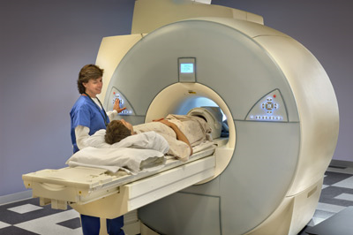
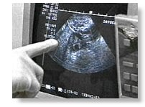
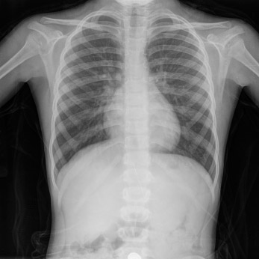
Medical Limitations
Rather than using ultrasound to view these areas, your doctor may instead order other imaging tests, such as CT or MRI scans, or X-rays.

Slide 28
Risks?
Ultrasound has been used in medical practice throughout the world for at least 50 years for diagnostic scanning.
At present there is very little scientific information available with which to assess the impact of exposure to ultrasound, particularly on the unborn child. However, antenatal ultrasound scans have been used for many years without apparent ill-effects.

Slide 29
Risks?
While data are not considered to provide clear evidence of a specific hazard, the possibility of subtle long-term effects cannot be ruled out.
As well as this, the evidence on the effects of fetal ultrasound in humans mainly date from some time ago, and used different techniques and lower exposures than are used today.
There is little direct evidence on the safety of modern techniques, but no ill effects have been reported.

Slide 30
Other Uses: Ultrasonic Weapons
Use ultrasound waves to injure, incapacitate or kill.
Designed to emit sound as an irritant.
Effective for crowd and riot control.
Used by maritime, law enforcement, military and commercial security companies.

Slide 31
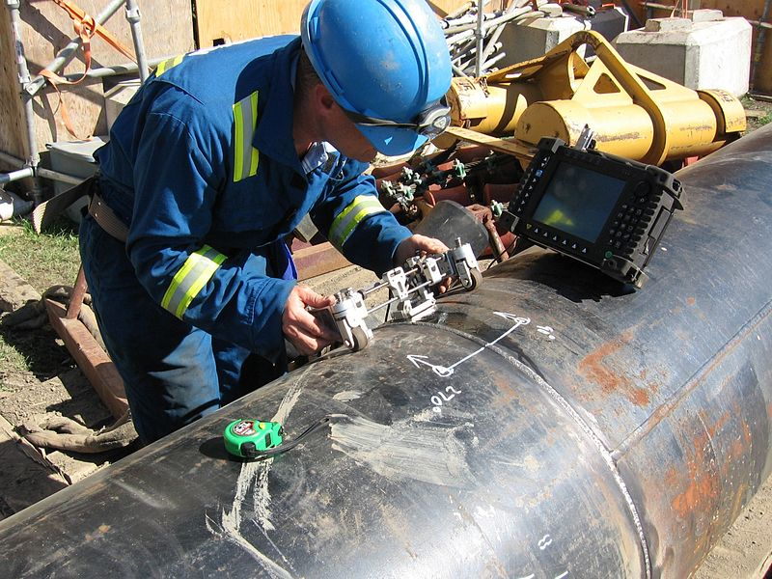
Ultrasonic Testing
A form of non-destructive testing.
Used to implement quality assurance.
Measures the thickness of objects to monitor corrosion.
2-10MHz sound waves.

Slide 32
Ultrasonic Cleansers
Emit sound waves at frequencies between 20-40kHz.
Used to clean jewelry and various instruments.
Employs similar techniques to ultrasonic disintegration.
http://www.youtube.com/watch?v=nOVUpenSvdw

Slide 33
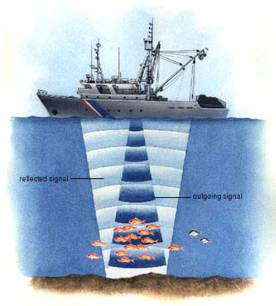
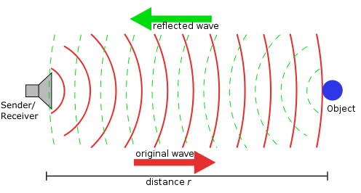
Ultrasonic Range Finding
SONAR and RADAR.
Detect emitted sound waves as echoes returning from object for analysis.

Slide 34
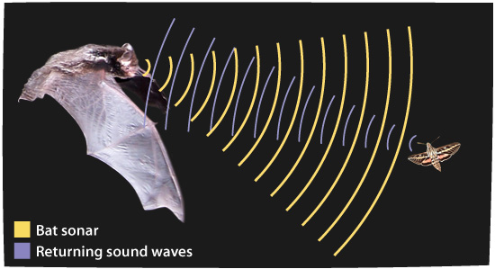
Ultrasound Waves in Nature
Bats use echolocation to prey on insects.
Insects use ultrasonic hearing to avoid predatory bats.
Dolphins and whales posses ultrasonic hearing to orient and capture prey.
Pistol shrimp are awesome…and this is why.
http://www.youtube.com/watch?v=XC6I8iPiHT8

Slide 35
References
Acoustics and Vibration Animations “the Doppler Effect and Sonic Booms” www.acs.psu.edu
Ehealth.com
Gastroenterology Associates. giassociateschicago.com
Medicalphysicsweb.org
Nicolaides, K., G. Rizzo, K. Hecker, & R. Ximenes. Doppler in Obstetrics. www.centrus.com/br
www.radiologyinfo.org
www.ultrasonics.org
www.webmd.com
www.wikiradiology.com

Slide 36
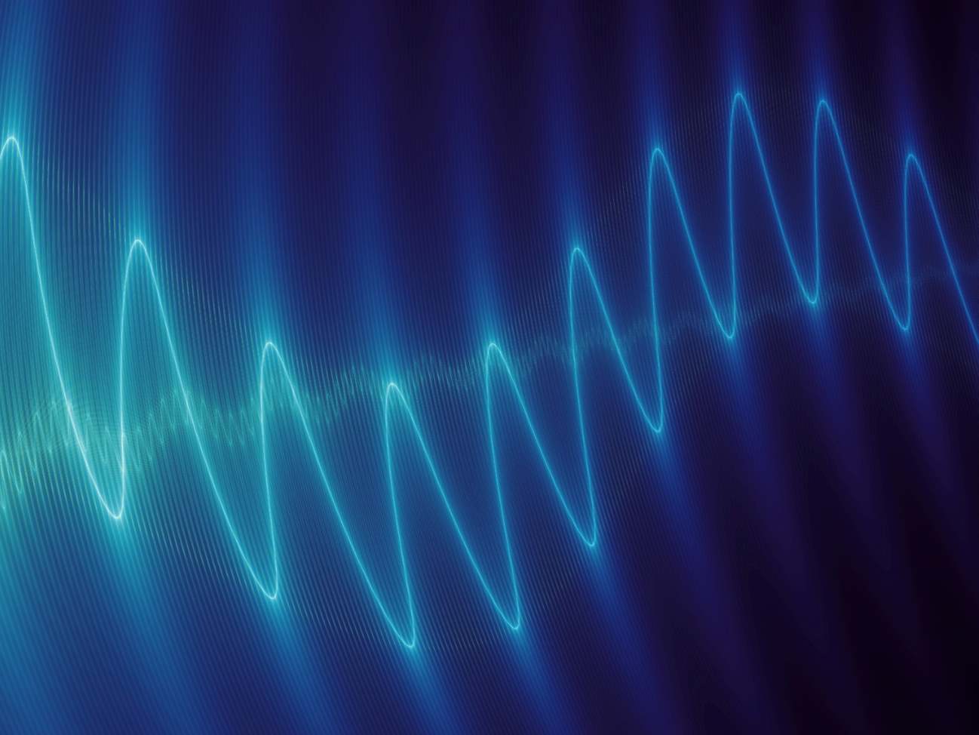
Questions?

