Slide 1
MIT Museum

Slide 2
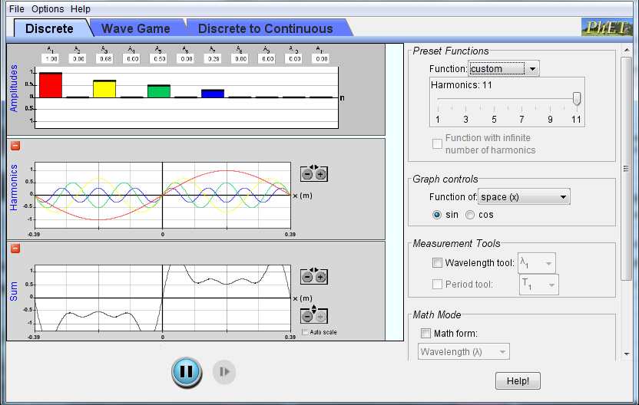
Fourier
What did you learn??

Slide 3
Perception
Can pick out one frequency

Slide 4
Wave addition simple pulse
1. The pulse on the left is moving right, the pulse on the right is moving left. What do you see when the pulses overlap?
Notes:
Adapted From Pollock at CU course: Physics of Sound and Music for nonscientists there are a total for 4 slides for this

Slide 5
Rest of question
Notes:
http://www.physics.nyu.edu/~ts2/Animation/waves.html

Slide 6
answer
B

Slide 7
After interacting

Slide 8
2. If these two waves were moving through water at the same time, what would the water look like?
Wave 1
A
x
B
Wave 2
x
C
D
Notes:
D

Slide 9
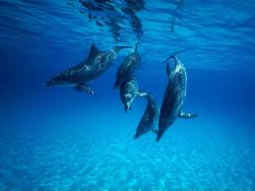
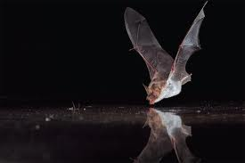
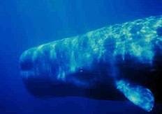
Echolocation

Slide 10
Sound bounces off of different materials

Slide 11
Listen for echoes
Echolocators listen for the sounds bouncing back
Most produce their own sounds (such as clicks) and listen for them to come back.
People do this subconsciously

Slide 12
Results of Wednesday’s Project:
How many times did someone grab an object successfully?
What was hardest location?
Was everyone equally as good?
Could you tell the short side of the room?

Slide 13
Locating sounds

Slide 14
Listen for the delay
The delay tells the brain how far away an object is.
If one ear hears it first, then it knows the object is on that side.

Slide 15
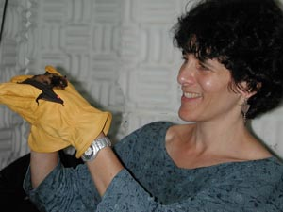
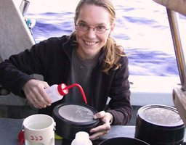
Acousticians
Animal bioacousticians
Underwater acousticians
P &P : Physical and Psychological
Audiologists
Psychology
Electrical Engineering and Marine Biology

Slide 16
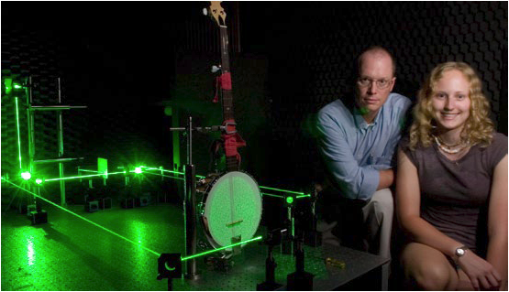
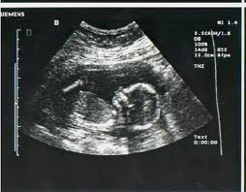
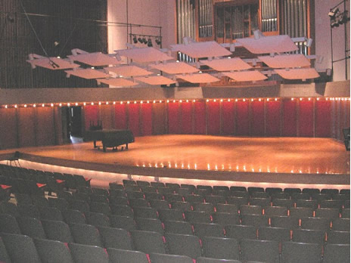
Acousticians
Physicist
Musical Instrument Designers
Speech scientist
Medical acoustics
Architectural acousticians
Concert Halls
Vibration (ie. Bridges)

Slide 17
Audi Sound Engineers
How many different types of acoustics jobs are included in this video?

Slide 18
MIT Museum

Slide 19
How many different types of acoustics jobs are included in this video?
Musicians
Marketing - Sound Designers
Mechanical Engineers
P &P (psychological)
….
Main Point: Audi is trying to create a distinct sound that is associated with their brand name and the marketing which goes into their product.
Their ability to reach their goal depends on how well their audio engineers and sound design team understand basic principles in acoustics.

Slide 20
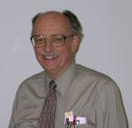
Bob Coffeen
2012 Acoustics Education Prize
University of Kansas
School of Architectural
Design and Planning
Acoustics is often not required

Slide 21
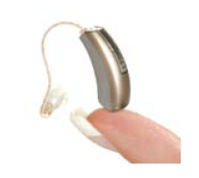
PLEASE NOTE THAT I WEAR HEARING AIDS…
AND SO WHAT!
I BEGAN USING HEARING AIDS SEVERAL YEARS AGO BECAUSE I WAS HAVING SOME PROBLEMS UNDERSTANDING STUDENTS IN MY CLASSES
Slides courtesy of Bob Coffeen

Slide 22
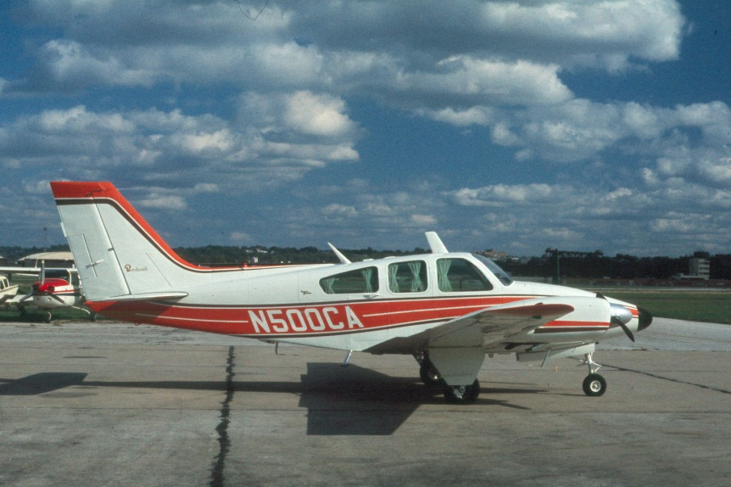
THESE AUDIOGRAMS INDICATE THAT MY HIGHER FREQUENCY HEARING IS NOT DOING TOO WELL.
A COMPANY BUS AND TRUCK
MAYBE FLYING NOISY LIGHT AIRCRAFT FOR MANY YEARS, MOST OF THE TIME WITHOUT EAR PROTECTION

Slide 23
LET'S TAKE A LOOK AT SOME FREQUENCY STUFF AND ITS RELATION TO SPEECH INTELLIGIBILITY
HEARING FREQ. RANGE FOR YOU YOUNG GUYS
HEARING FREQ. RANGE FOR SOME OF US "MATURE" GUYS
PIANO
TWO Cs ABOVE MIDDLE C
MIDDLE C
YOUR STEREO SYSTEM (PERHAPS SOME WISHFUL THINKING HERE)
NATURALNESS
SPEECH
VOWELS CONSONANTS
INTELLIGIBILITY
FULL RANGE SPEECH
SPEECH AT 250 Hz AND BELOW
35%± OF SPEECH
INTELLIGIBILITY IS IN
2000 Hz OCTAVE BAND
WHAT IS AN OCTAVE?
20 31.5 63 125 250 500 1000 2000 4000 8000 16000 20,000
OCTAVE BAND CENTER FREQUENCY - Hz

Slide 24
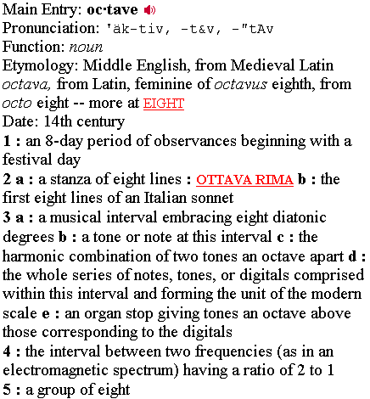

Slide 25
LET'S BACK UP A BIT…
WHAT IS SOUND?
One definition is…
Wave motion consisting of very small changes in air pressure which cause our eardrums (tympanic membrane) to "wiggle" (vibrate)

Slide 26
What two parameters must be identified to describe any sound?
Frequency (Pitch)
Amplitude (Intensity…Pressure)

Slide 27
How do we describe frequency?
Repetition rate in
Cycles per second
Hertz (Hz)

Slide 28
How can we describe the frequency content of a sound?
By determining the sound pressure level within an octave frequency band or subdivisions of an octave band such as one-third octave band, one-sixth octave band, etc.

Slide 29
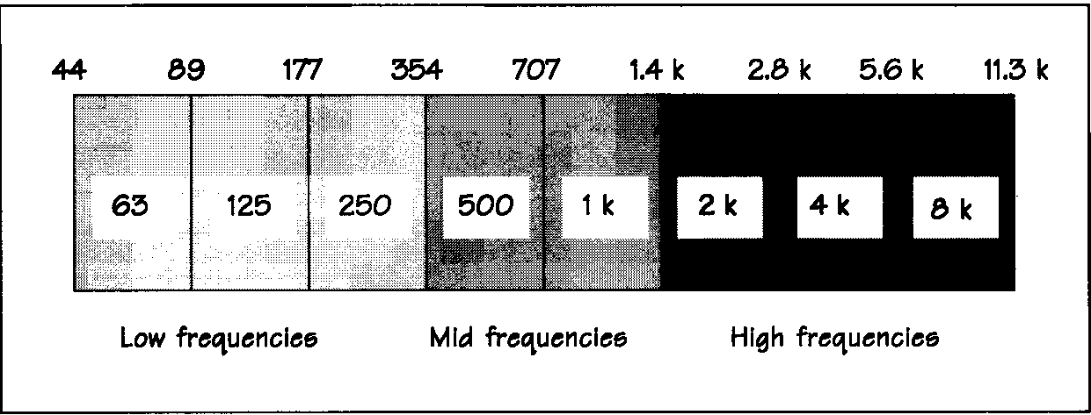
From Metha Johnson Rockafort text
The center frequencies of octave frequency bands have been standardized and are accepted the world over.
The upper and lower frequency limits can be determined as follows:
Upper limit = (center freq) 2^{1/2} = (center freq) 1.414
Lower limit = (center freq)/2^{1/2} = (center freq) 0.707

Slide 30
THUS FAR WE HAVE TALKED ABOUT OCTAVE FREQUENCY BANDS. BUT, FOR HIGHER RESOLUTION IN DESCRIBING THE SPECTRUM OF A SOUND, WE OFTEN USE ONE-THIRD OCTAVE BANDS…
CENTER FREQ.- Hz | CENTER FREQ.- Hz
50 | 1000
63 | 1250
80 | 1600
100 | 2000
125 | 2500
160 | 3150
200 | 4000
250 | 5000
315 | 6300
400 | 8000
500 | 10000
630 | 12500
800 | 16000
One-third octave bands are said to be 23 percent bands. The band width is approximately 23 percent of the center frequency.
THE OCTAVE FREQ BAND CENTERED AT 250 Hz CONTAINS THE ONE-THIRD OCTAVE BANDS CENTERED AT 200, 250, AND 315 Hz
STANDARD OCTAVE BAND CENTER FREQUENCIES ARE SHOWN IN RED
For octave bands the center frequency is multiplied by 2 to obtain the center frequency of the next higher band.
For one-third octave bands the center frequency of a 1/3 octave band is multiplied by 2^{1/3} (1.26) to obtain the center frequency of the next higher band.

Slide 31
Let’s see how we can observe the frequency characteristics of a particular sound
WE'LL LOOK AT MEASUREMENTS FROM THE COMPUTER PROGRAMS EASERA and systune

Slide 32
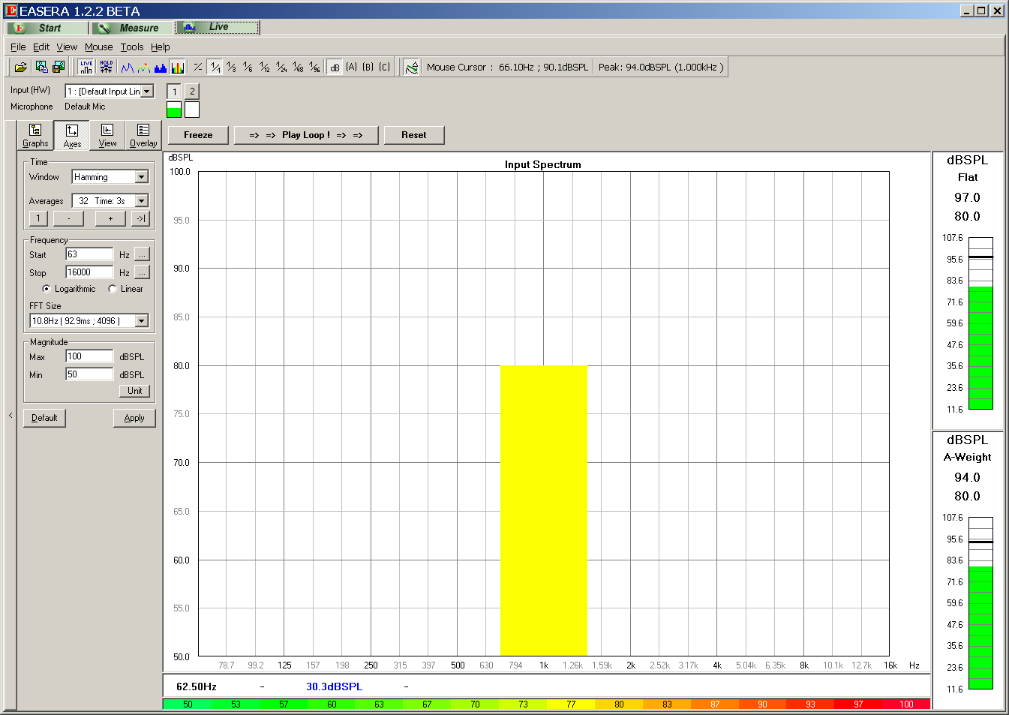
ANALYZER SET TO DISPLAY FULL OCTAVE FREQUENCY BANDS
1000 Hz OCTAVE BAND EXTENDS FROM ABOUT
700 Hz TO 1400 Hz
WIDTH OF BAND IS 70% OF CENTER FREQUENCY,
IN THIS CASE 700 Hz.
THIS GRAPHIC INDICATION ON THE ANALYZER SHOWS THAT THE SUM OF ALL SOUND ENERGY IN THE 1000 Hz OCTAVE BAND IS AT A LEVEL OF 80 dB
OCTAVE BAND CENTER FREQUENCY DOUBLES FOR EACH HIGHER FREQUENCY OCTAVE BAND
WE HAVEN'T YET DEFINED dB (DECIBEL) BUT WE WILL DO SO SOON

Slide 33
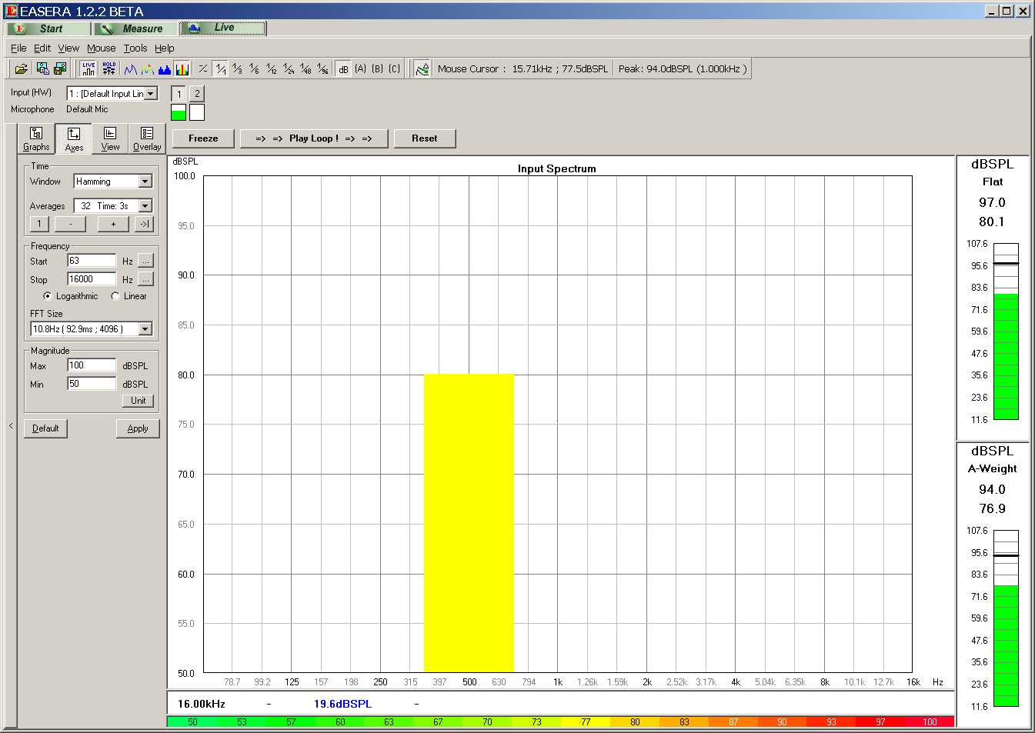
500 Hz OCTAVE BAND EXTENDS FROM ABOUT
350 Hz TO 700 Hz
WIDTH OF BAND IS 70% OF CENTER FREQUENCY,
IN THIS CASE 350 Hz.

Slide 34
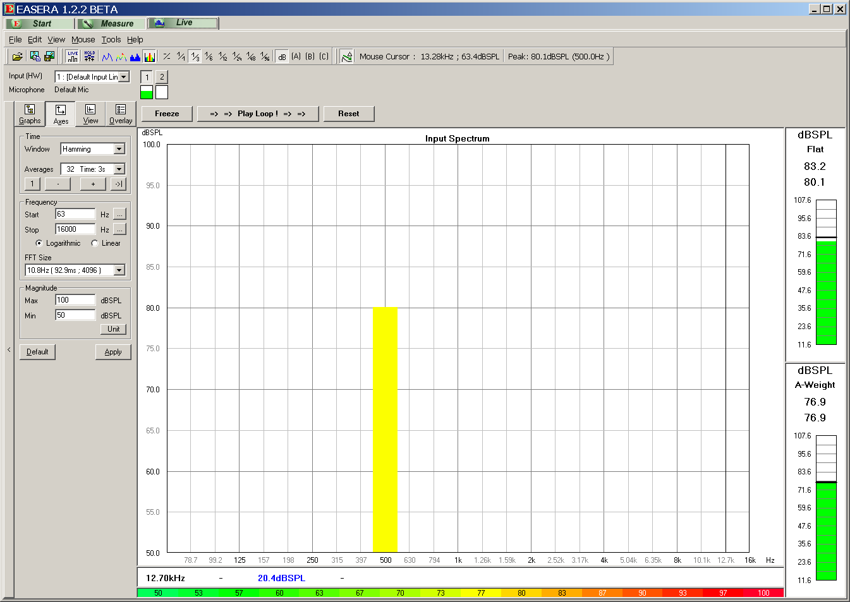
ANALYZER SET TO DISPLAY 1/3 OCTAVE FREQUENCY BANDS
500 Hz 1/3 OCTAVE BAND EXTENDS FROM
446 Hz TO 560 Hz
THIS GRAPHIC INDICATION ON THE ANALYZER SHOWS THAT THE SUM OF ALL SOUND ENERGY IN THE
500 Hz 1/3 OCTAVE BAND IS AT A LEVEL OF 80 dB
FOR 1/3 OCTAVE FREQUENCY BAND WIDTH OF BAND IS APPROXIMATELY 23% OF CENTER FREQUENCY, IN THIS CASE 114 Hz

Slide 35
Noise is often used as a test signal or for other uses.
What are the frequency characteristics of pink noise and white noise?

Slide 36
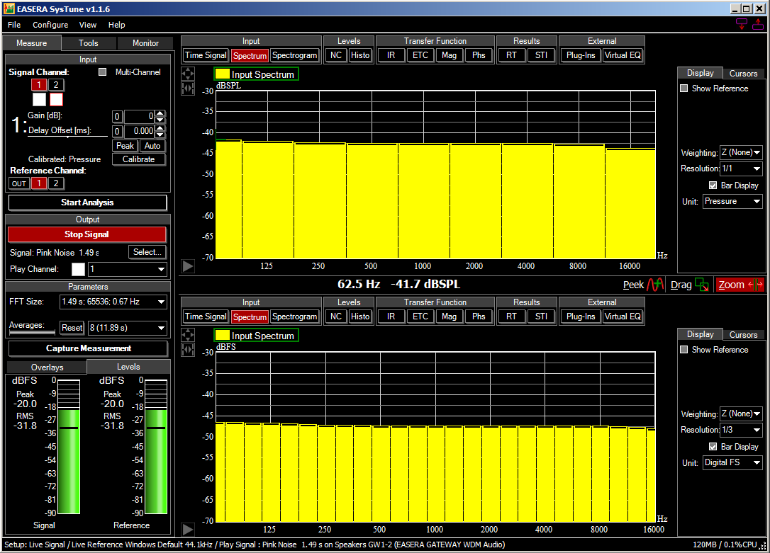
LISTEN TO PINK NOISE
PINK NOISE – EQUAL ENERGY IN EVERY "CONSTANT PERCENTAGE" BANDWIDTH…OCTAVE BAND, 1/3 OCTAVE BAND, ETC… APPEARS "FLAT" (OR NEARLY "FLAT") WITH FREQUENCY
OCTAVE FREQ. BANDS
1/3 OCTAVE FREQ. BANDS

Slide 37
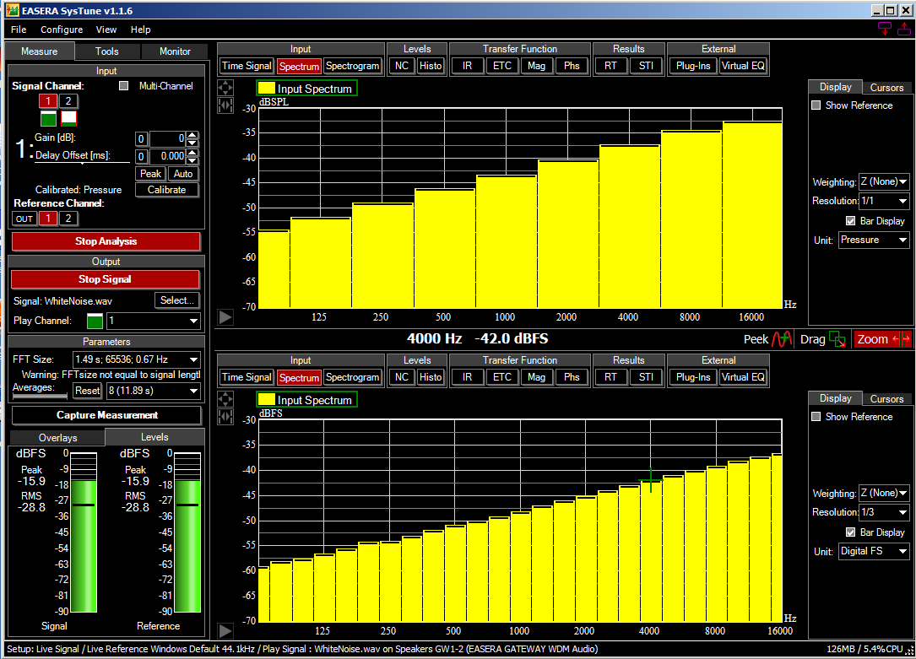
LISTEN TO WHITE NOISE
WHITE NOISE – EQUAL ENERGY IN EVERY CYCLE…WHEN ANALYZED IN OCTAVE FREQUENCY BANDS THE LEVEL INCREASES WITH EACH HIGHER FREQUENCY OCTAVE BAND BY 3 dB. WHEN ANALYZED IN 1/3 OCTAVE FREQUENCY BANDS THE LEVEL INCREASES WITH EACH HIGHER 1/3 OCTAVE BAND BY 1 dB.
OCTAVE FREQ. BANDS
1/3 OCTAVE FREQ. BANDS
ANALYSIS BY EASERA SYSTUNE

Slide 39
Frequency Attenuation
Which travel further – high frequencies or low frequencies?

Slide 40
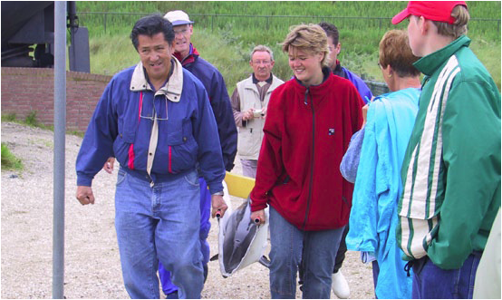
Dolphins
Use lower sounds in captivity
Use higher frequency in the wild
Why?
Electrical Engineer then Marine Biologist
Whit Au discovered in 1974

Slide 41
Whit’s answer
First of all, absorption losses increase with frequency. So the higher the frequency the more the absorption losses will be for a given range.
Secondly, the center frequency of the output signals tend to increase with amplitude. In other words, the higher the output the higher the frequency content will be.
In small tanks, dolphins tend to use much lower amplitude bisonar signals than in large tanks or net-enclosure in open bays. The temporal resolution will be dependent of the bandwidth of the signal - higher bandwidth better resolution. The bandwidth tend to be wider for high frequency signals. So, in many situations, its hard to generalize since the biosonar signals dolphin use depends on the specific situation. Their system seems to be very flexible so dolphins tend to adapt to the situation.

