Slide 1
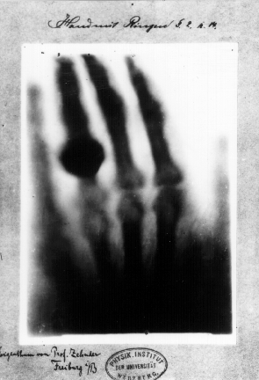
X-RAYS
Waft 1, 3, & 6

Slide 2
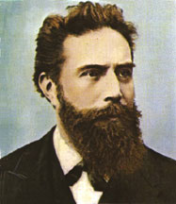
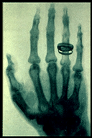
On a fine day in Germany in 1895…
Physicist Wilhelm Roentgen was playing around with a cathode ray tube in his laboratory. Eventually, he noticed that whatever he put in the tube was producing a fluorescent glow. To further investigate, he covered the tube with heavy black paper in hopes of shielding the light. But the fluorescent light could still be seen!
What could be passing through such a dark and heavy material? X-rays! (Termed “x” because he really had no idea what they were).
His first experiment with human tissue involved a test subject (his lovely wife Bertha) and her right hand. Note the fancy ring.

Slide 3
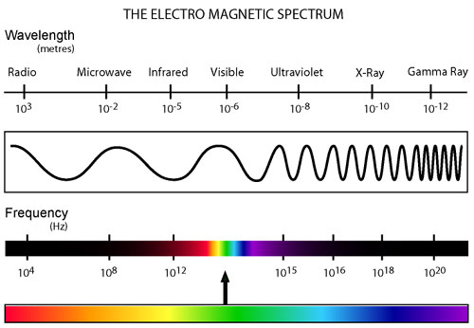
X-ray Light
Wavelength between .01 and 10 nanometers
Frequency between 3x10^16 and 3x10^19
Wavelength shorter than radio waves, microwaves, visible light and UV rays
X-rays travel in straight lines, like visible light

Slide 4
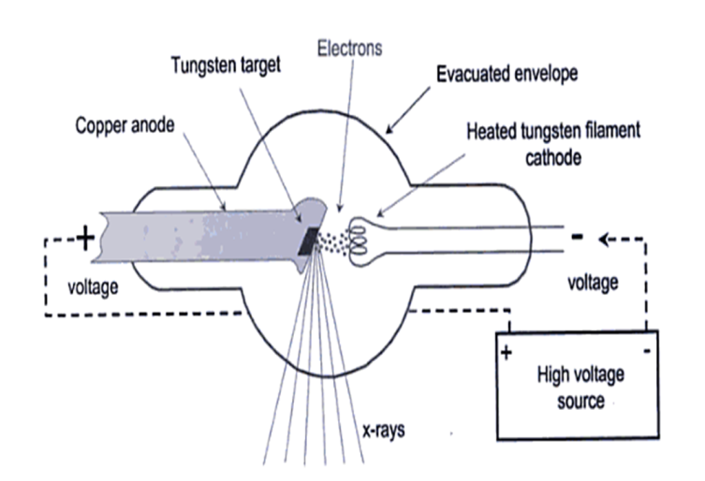
How do they work?
In an x-ray tube, a cathode is heated and electrons are emitted and shot toward an anode, which has a metal target.
This target is generally made up of a metal with a very high melting point because the majority (99%) of the electron’s energy is converted into heat.
Between the cathode and the anode, there is an electric field and a large potential difference, which accelerates the electrons because they gain kinetic energy.

Slide 5
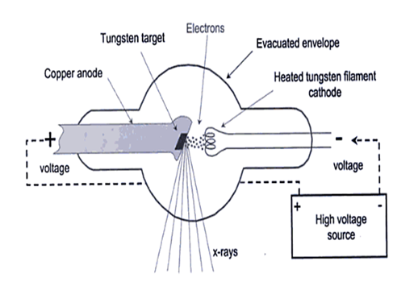
How do they work?
As the electrons strike the metal target, they rapidly slow down and cause the emission of photons and a release of kinetic energy. The high-energy photons that are emitted are x-rays.
These x-rays then pass through a window in the tube and can produce an image.
Similar to light rays, an x-ray affects photographic film by passing a beam of x-rays through the subject onto photographic film

Slide 6
X-ray Tube

Slide 7
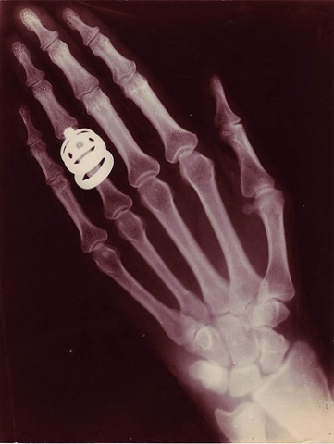
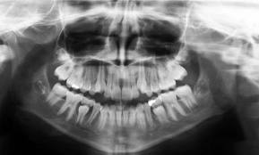
X-ray Images
Film is placed under the body before the x-rays are emitted. Once emitted, the X-rays interact with the body and either get absorbed or just pass through.
Objects that have a higher atomic number, such as lead or minerals in bones, are more likely to absorb the X-rays, whereas tissues like muscle and fat do not.
Because the film is a negative, it is initially white. Therefore, when the X-rays pass through the tissues and other areas that are not covered by dense materials it exposes the film and turns it black. The areas that absorb the X-rays, such as lead and bones, are left white. Thus an X-ray image is formed!

Slide 8
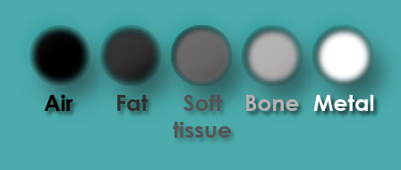
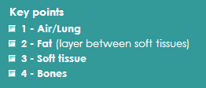
X-ray Images

Slide 9
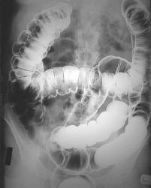
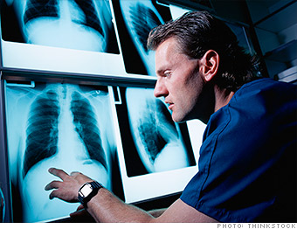
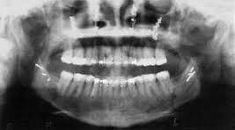
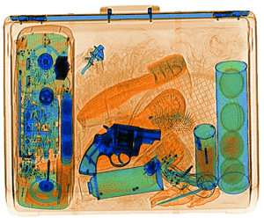
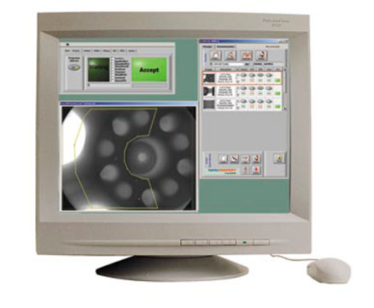
Uses of X-rays
Fluoroscopy- continuous
x-rays to show internal movement.
Radiographs.
Security.
X-rays of Paintings- used to determine age and brush strokes used.
Product defect testing.

Slide 10
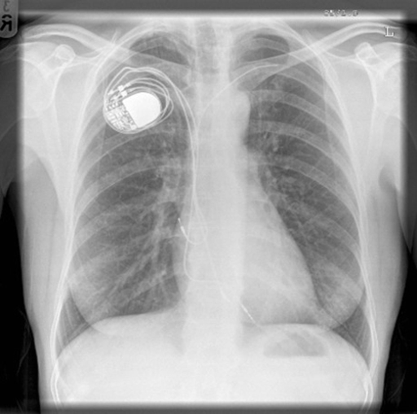
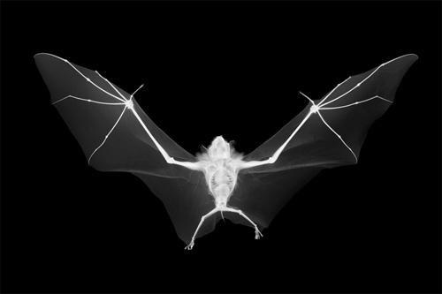
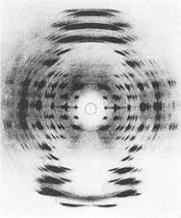
Uses of X-rays continued…
X-ray art.
Medical Radiography.
Astronomy.
Crystallography.

Slide 11
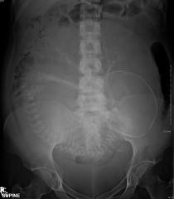
Radiation
Ionizing Radiation
Short wavelength of Ultraviolet Spectrum
Have sufficient energy to ionize atoms
Strikes tissue, then can produce cellular damage
Very Penetrating
Absorption is greater in materials made of atoms with more electrons
Used in medical field because calcium in bones has many more electrons, increases absorbency

Slide 12
Risks of X-rays
X-RAYS ARE…
SO THEY CAN LEAD TO…
A type of high energy ionizing radiation. When this type of radiation passes through the body, it can cause electrons to do two things:
Be ejected from atoms, leaving behind positive ions
Move to a higher energy state
These excitations and ionizations can produce free radicals, break or produce chemical bonds, damage DNA/RNA and proteins.
At low doses, cells can repair the damage. At higher levels, repair is much more difficult.
DNA mutation that can lead to random cell division and even tumor formation
Birth complications and birth defects in the baby itself
Damage to red blood cells that can lead to anemia
Damage to white blood cells that can lead to a lowered immune system
Skin conditions that resemble burns
Localized cancer or cataract formation
Use of a lead shield can prevent x-ray penetration.

Slide 13
Dosage Facts
Today, x-rays are regulated so that patients receive the minimum amount of radiation necessary to produce a useful image.
Below is a list of procedures and their equivalent radiation exposure (as compared to what we naturally receive daily from cosmic, terrestrial, and internal sources)
Chest x-ray= 2.4 days natural background radiation
Skull x-ray= 12 days natural background radiation
Lumbar spine= 182 days natural background radiation
I.V. urogram= 1 year natural background radiation
Upper G.I. exam= 2 years natural background radiation
Barium enema= 2.7 years natural background radiation
CT head= 243 days natural background radiation
CT abdomen= 2.7 years natural background radiation
Even with some x-rays giving you multiple years worth of radiation, most doctors agree that the benefits of having the x-ray taken outweigh the risks.
Keep in mind though that the effects of x-ray radiation is cumulative. Therefore, multiple minor doses over a number of years is equivalent to a large dose at one time.
Fun fact: The amount of radiation received from a chest x-ray is proportional to the amount of radiation you would receive after eating 3-4 bags of Brazil nuts!

Slide 14
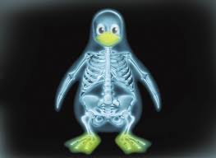
Interesting Facts
X-rays were discovered accidentally in 1895
X-rays are unable to penetrate through the Earth’s atmosphere
The binaries (cluster of stars) output 1000x more x-radiation than the Sun.
X-rays are emitted outside of the nucleus where gamma rays are emitted by the nucleus.
The first documented x-ray was of Rontgen’s wife’s hand.
X-rays are developed on negative film paper

Slide 15
Sword Swallower

Slide 16
Top 10 Strangest and Unusual X-Rays

