Slide 1
Electron Microscopy!
Kane Smith, Garrett Luallen and Jesse Gurule

Slide 2
History
The electron microscope was first invented by German engineer Max Knoll and physicist Ernst Ruska in 1932
They used Louis de Broglie’s theory of electron waves developed in 1924
If you increase a particle’s momentum, its wavelength will decrease, allowing for higher resolution.
Having higher resolution means having a higher degree of detail visible in a photographic image.

Slide 3
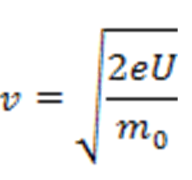
History
Velocity
Need to know mass of electron, its charge and electric potential
80 kV electrons have a velocity of 150,000 km/s (1.5 x 10^8 m/s)
Wave particle duality concept of quantum physics asserts that all matter exhibits both wave and particle like properties

Slide 4
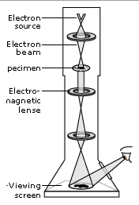
Mechanics
Electron microscopy uses a beam of electrons instead of light (photons)
A series of electromagnetic lenses and apertures are used to reduce the diameter of the beam

Slide 5
Mechanics
Electromagnetic Lens
An electromagnetic lens is a coil of wire through which current flows.
Lenses for electrons are constructed with ferromagnetic materials (iron/nickel) and windings of copper wire.
These produce a focal length which can be changed by varying the current through the coil.
Because the current flow produces a magnetic field at right angles, the field pushes inwards into the hole in the center.

Slide 6
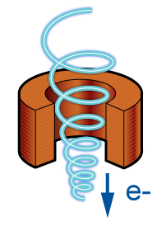
Mechanics
Electromagnetic Lens
The magnetic field bends electron paths in a similar way that solid glass lenses bend light rays.
Electrons assume a helical path, spiraling down the column to place a small, focused beam of electrons (or spot) onto the specimen.

Slide 7
Mechanics
Electron Gun
The electron gun produces a steady stream of electrons that bombard the object being observed.
There are two ways of producing a steady stream of electrons necessary for scanning.
Thermionic guns
Field Emission guns

Slide 8
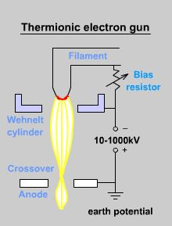
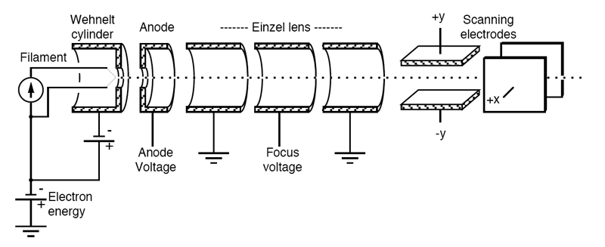
Mechanics
Thermionic Guns
These are the most commonly found electron guns.
They apply thermal energy to a filament (tungsten) until electrons jump from the filament and are focused into a beam by electrodes creating an electric field towards the object.

Slide 9
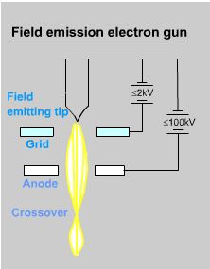
Mechanics
Field Emission Guns
These guns create a strong electrical field to pull electrons away from the filament that bombard the object.
These guns often give a brighter picture, but require very good vacuums.

Slide 10
Mechanics
Detectors
When the beam of electrons bombards the object, it dislodges electrons from the object being scanned. These are called secondary electrons.
Secondary electrons do not have as much energy as all of the bombarding electrons and are attracted to the Everhart-Thornley Detector by a weaker electrical grid (+200V), then it is accelerated with a stronger (+15000V) grid.

Slide 11
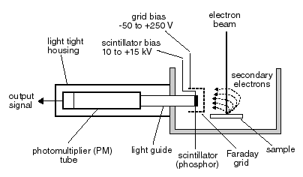
Mechanics
Detectors Continued…
When the secondary electrons are accelerated, they create enough energy to create a flash that is detected by the Everhart-Thornley Detector which sends the info to a computer screen.

Slide 12
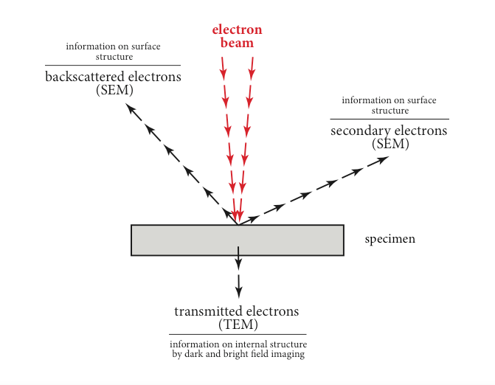
Types
Overview

Slide 13
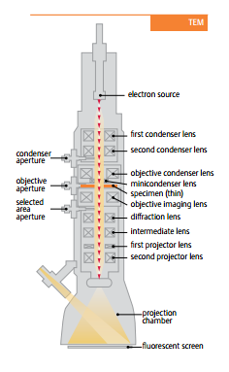
Types
Transmission Electron Microscopes
Primarily used to view thin specimens
Beam speed is between 40 and 400 kiloelectron volts
Works like a projector
Specimen limited to 100 nm thickness
Cannot view surface
Specimen must be in a vacuum

Slide 14
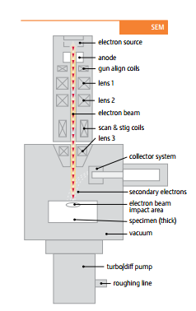
Types
Scanning Electron Microscopes
Beam speeds between 50 and 30,000 volts
Beam interact with surface and reactions are recorded by sensors
Interacts by include producing heat, producing low energy electrons, high leveled backscattered electrons, light and/or x-ray emissions
Rotate the specimen in X,Y and Z directions
Specimen must be in a vacuum

Slide 15
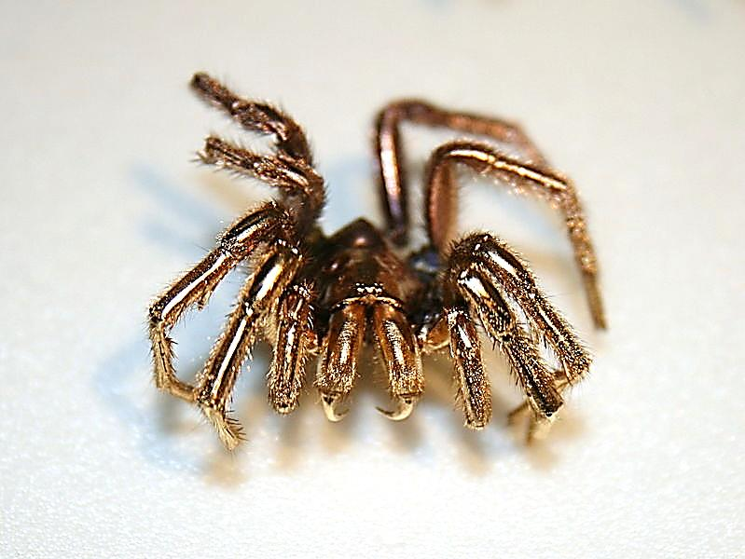
Downfalls
Although the electron microscope seems like a positive and simple machine, it has its downfalls.
The electron microscope is rather hard on some objects. This means that extra steps need to be taken to preserve the object such as plating, dehydration, or freezing.
It also creates a small amount of radiation that can be harmful to the operator

