Slide 1
CT/CAT Scans
Wednesday night and Thursday
Lab Mega Group

Slide 2
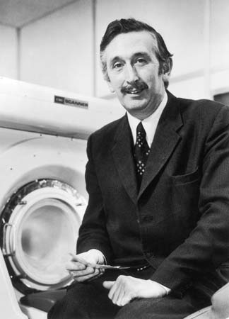
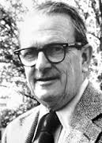
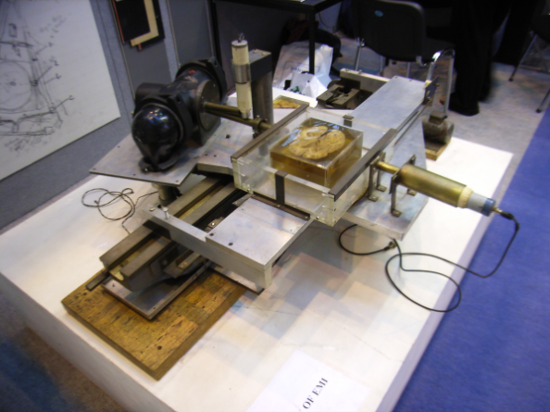
History of the CT/CAT Scan
1967: The first Computer Tomography (CT) theory was developed
1972: The CT scan was invented by Godfrey Hounsfield and Allan McLeod Cormack
They were awarded the Nobel prize in medicine and science in 1979
1972: The first clinical CT image of the head was created
1976: Full body scans became practical

Slide 3
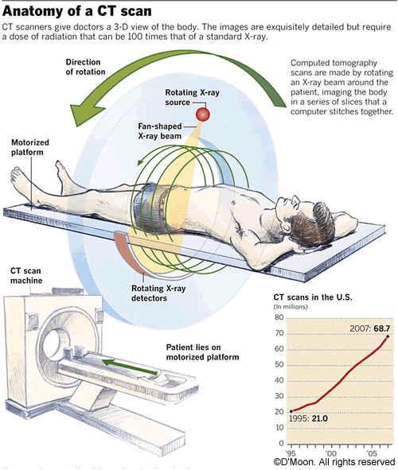
What is a CT/CAT Scan?
CAT Scan stands for Computerized Axial Tomography
Computerized Tomography is a process that utilizes electromagnetic waves (X-rays) to combine cross-sectional slices (voxels) to construct a 3D image
A series of X-rays taken in a 360⁰ rotational scan around a single axis are integrated to form a complete image of the target area
This entire process uses digital geometry to generate the image

Slide 4
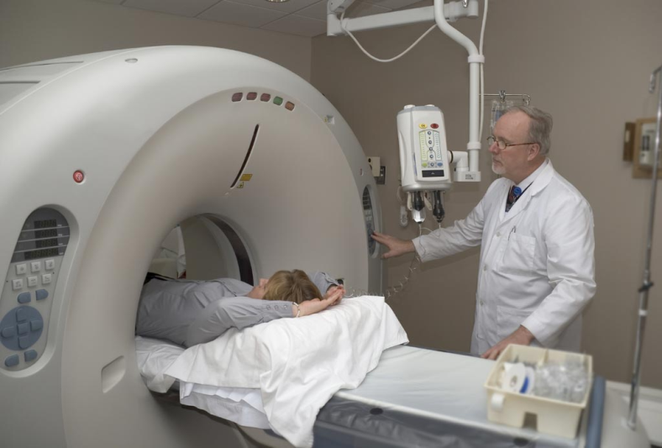
What Makes Up a CT/CAT Scan Machine
The scanner consists of a motorized platform the patient lays down on and an upright machine with a “doughnut hole” (aka gantry)
An x-ray source above the patient sends photons through their tissues and onto an x-ray detector
X-ray source and detector will rotate around the gantry
The scanner compiles images in slices and sends them to a computer in a separate control room
Images are then stitched together and analyzed by a radiologist

Slide 5
Physics of CT/CAT Scans
X-rays:
Electrons from a cathode are accelerated until they have several thousand eV of energy
Electrons hit a target metal electrode (anode)
Rapid deceleration causes release of high energy photon (x-ray)

Slide 6
Physics continued
Attenuation coefficient: how much energy is absorbed by a passing photon
Depends on energy of photon and composition of the material
Different tissues absorb different levels of photons- the more dense the material the higher the absorption

Slide 7
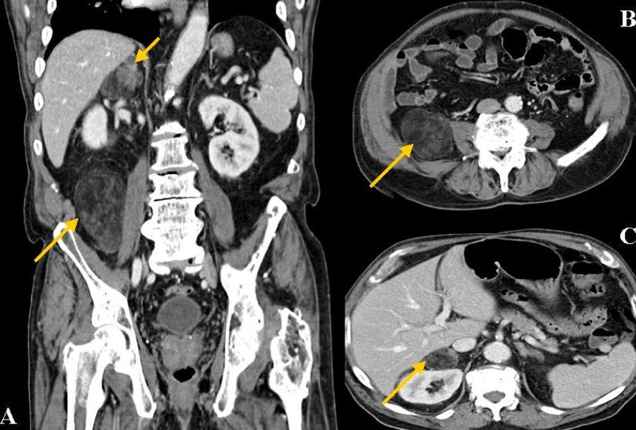
Physics of the Production of a CT/CAT Scan Image
As x-ray source rotates around gantry, x-ray photons are absorbed by the different tissues
An electronic detector measures the intensity of the x-rays passing through the tissues
A computer compiles information from the electronic sensor to produce an image
The darker the shade the
more x-rays that pass
through the tissue
Notes:
My slide

Slide 8
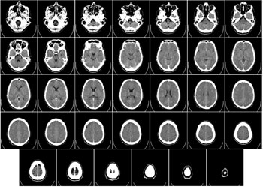
Diagnostic Use
Preventative medicine, screening for disease, and diagnosis of abnormal structures
Head:
Hypodense (dark) = infraction/edema
Hyperdense (light) = calcifications, hemorrhage, and trauma
Lungs
Pulmonary angiogram:
Pulmonary arteries viewed through use of Iodine based contrast
Cardiac
Abdominal/Pelvic
Extremities
Has ability to show structure from
multiple planes

Slide 9
Benefits of CT/CAT Scans
Rapid Results
A full body scan can take approximately 30 minutes
Scans for specific organs can take only a few minutes
CT/CAT scan is relatively quiet
Sedation is rarely necessary
Machine is relatively open
Allows for the formation of a 3D image of tissues
Good for detecting all types of cancers while in early stages
Cross-sectional image- gives size and depth of abnormality
Safe for patients with internal metal components

Slide 10
Cons of CT/CAT Scans
CT/CAT scans can emit 500 times the radiation of a conventional x-ray
But this is not much more than normal background radiation levels absorbed over a 1-3 year span
X-rays are dangerous to DNA- cause breaks in DNA backbone
Women who are pregnant are advised against this method
Risk of child developing cancer from CT/CAT scan is about 1 in 500

Slide 11
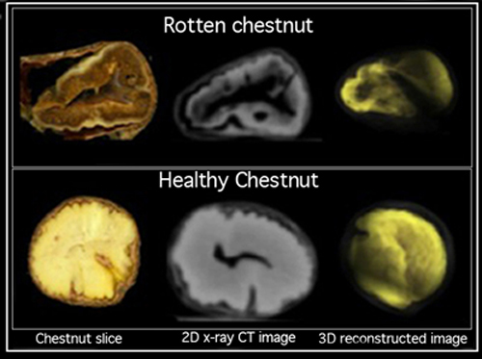
Fun Facts and Uses outside of Medicine!
Study of mummies and archaeological artifacts
Prevents destruction
Analysis of engineering designs
Failure analysis of internal components
Porosity and permeability of rocks
Used in drilling oil
Used to non-invasively determine internal decay in chestnuts- quality control

Slide 12
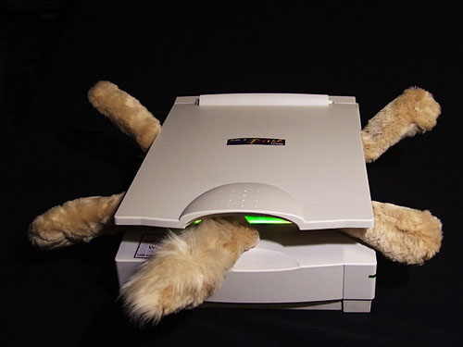
The End!!!!!!!
****No cats were harmed in the making of this presentation

