Slide 1
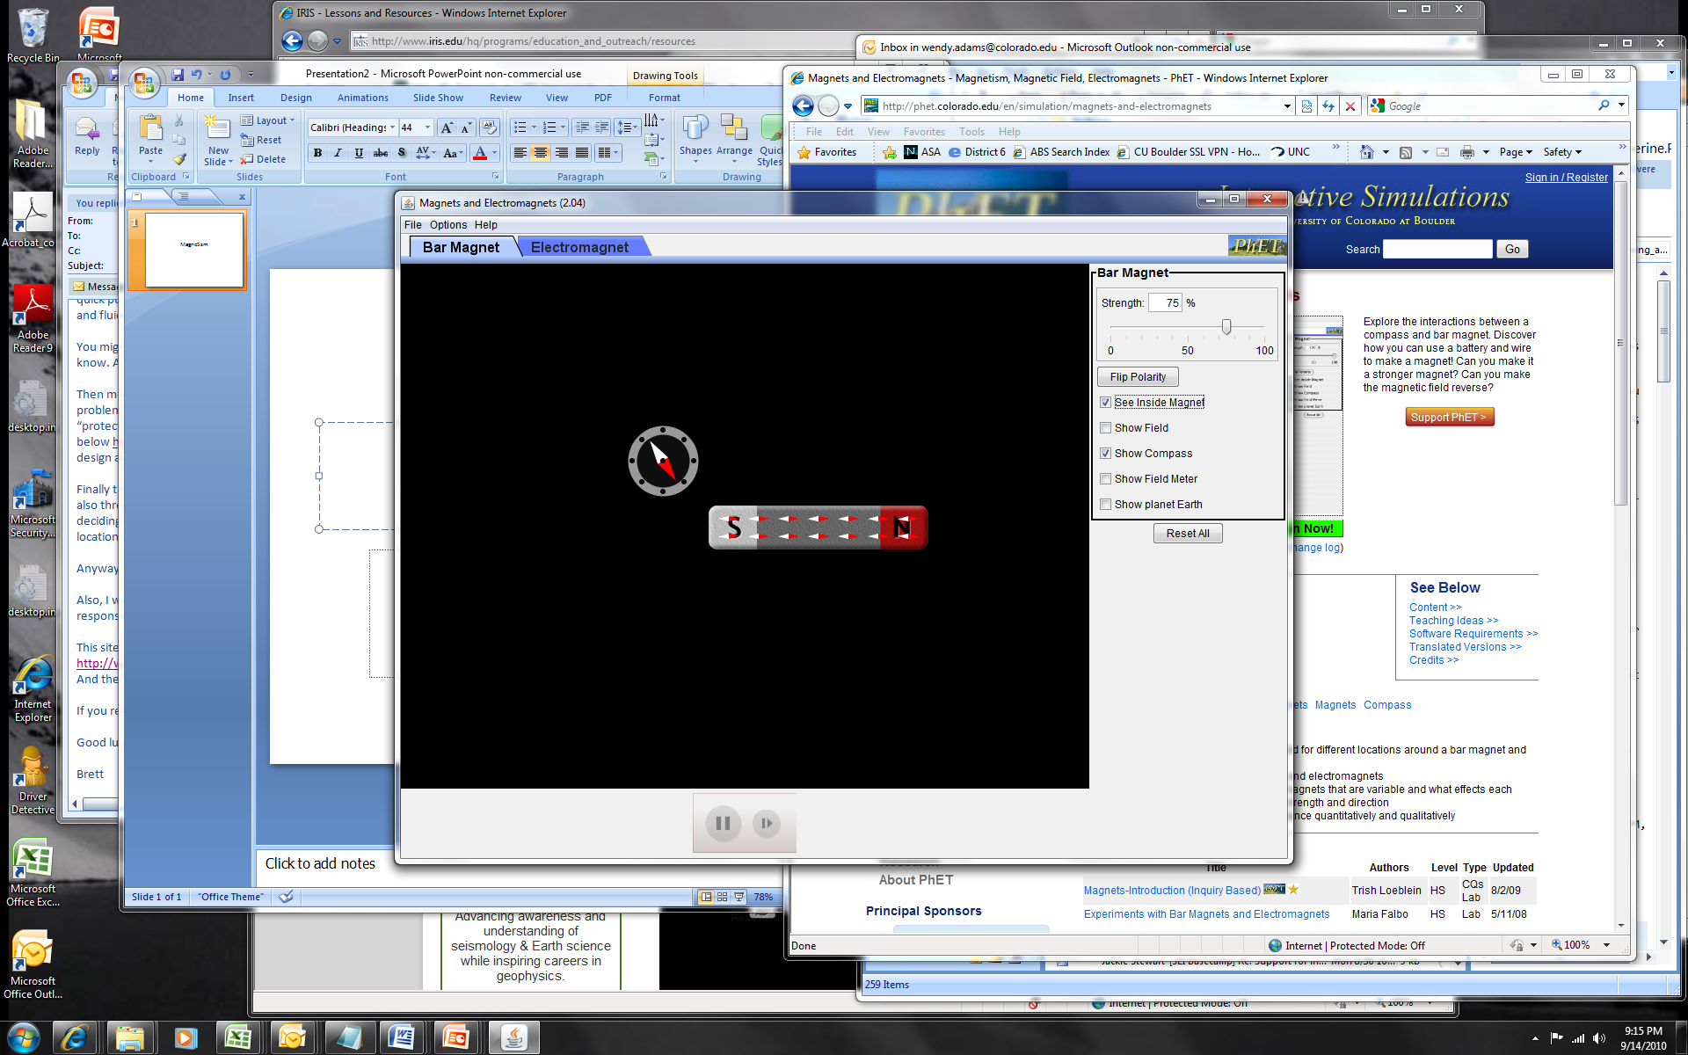
Magnetism

Slide 2
Non magnetic metal

Slide 3
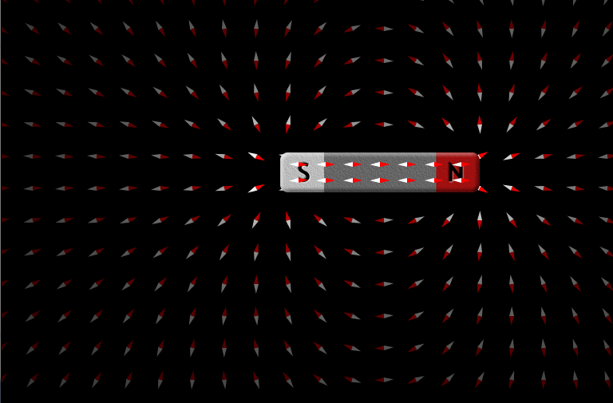
Hot (magma)

Slide 4
Hot (magma)

Slide 5
Cools – now have a magnet

Slide 6

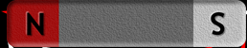
Other ways to make a magnet
Major blow while in a field
Rub on a magnet (if it’s iron or easy material to magnetize)
Store with a magnet for an extended time.

