Slide 1
Models of atoms and electrons and ions.

Slide 2
What happens if you remove one of the H’s (Hydrogen) from the red H₃O?
It becomes an ion
It is no longer H₃O, it’s now water
The whole thing falls apart.
Nuclear reaction – radiation
Nothing serious, it’s just charged now.

Slide 3
Where are the electrons in these pictures?
They are the smaller balls.
They are the bigger central balls
They are not shown
There are no electrons in H₂O or H₃O.

Slide 4
Where are the electrons in this picture?
a. The taupe dots
b. The red dots
c. The blue dots
d. The yellow dot

Slide 5
Model of an atom

Slide 6
What happens if you remove a proton?
It becomes an ion
It is no longer Helium, it’s now Hydrogen
The whole thing falls apart.
Nuclear reaction – radiation
Nothing serious, it’s just charged now.

Slide 7
What happens if you remove a proton?
It becomes an ion
It is no longer Helium, it’s now Hydrogen
The whole thing falls apart.
Nuclear reaction – radiation
Nothing serious, it’s just charged now.

Slide 8
What happens if you remove an electron?
It becomes an ion
It is no longer Helium, it’s now Hydrogen
The whole thing falls apart.
Nuclear reaction – radiation
Nothing serious, it’s just charged now.

Slide 9
What happens if you remove an electron?
+ positive ion
It becomes an ion
It is no longer Helium, it’s now Hydrogen
The whole thing falls apart.
Nuclear reaction – radiation
Nothing serious, it’s just charged now.

Slide 10
What happens if you add an electron?
It becomes an ion
It is no longer Helium, it’s now Hydrogen
The whole thing falls apart.
Nuclear reaction – radiation
Nothing serious, it’s just charged now.

Slide 11
What happens if you add an electron?
- negative ion
It becomes an ion
It is no longer Helium, it’s now Hydrogen
The whole thing falls apart.
Nuclear reaction – radiation
Nothing serious, it’s just charged now.

Slide 12
What happens if you remove a neutron?
It becomes an ion
It is no longer Helium, it’s now Hydrogen
The whole thing falls apart.
Nuclear reaction – radiation
Nothing serious, it’s just charged now.

Slide 13
What happens if you remove a neutron?
It becomes an ion
It is no longer Helium, it’s now Hydrogen
The whole thing falls apart
Nothing serious, it’s just charged now.
It becomes an ion
It is no longer Helium, it’s now Hydrogen
The whole thing falls apart.
Nuclear reaction – radiation
Nothing serious, it’s just charged now.

Slide 14
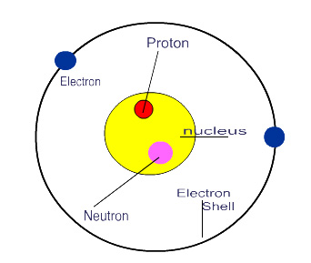
Allowed atom configurations
He (Helium) Atom
+ positive He ion
- Negative He ion
Extra electron Equal electrons and Missing an electron
protons

Slide 15
How do these two types of pictures go together?

Slide 16
Imagine the carpet molecules as atoms.
John is taking electrons away from the carpet atoms.
Not protons – it wouldn’t be carpet anymore
Not neutrons – it would disintegrate –nuclear fission
Not ions – wouldn’t be carpet anymore

