Slide 1
Deformation
Stress and Strain
Faults
Folds

Slide 2
Stress and Strain
Compression
  Forces opposite
  Act towards each other

Slide 3
Stress and Strain
Tension
  Forces opposite
  Act away from each other

Slide 4
Stress and Strain
Shear
  Forces opposite
  Act parallel
  But across a plane

Slide 5
Stress and Strain
Strain (Deformation)
  Change in shape or size
  Response to stress (or force)

Slide 6
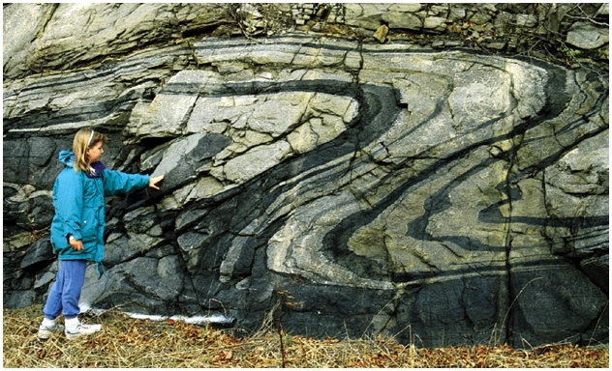

Slide 7
Stress and Strain
1) Elastic deformation
  Temporary change in shape or size
  Recovers when stress is removed

Slide 8
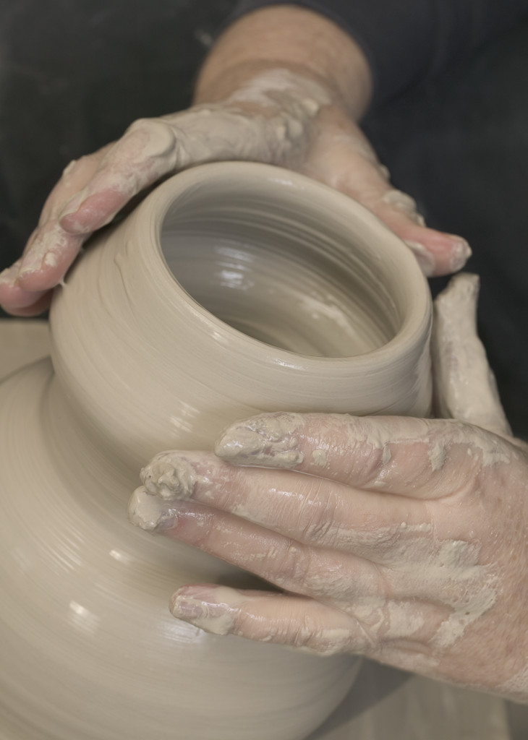
Stress and Strain
2) Ductile (plastic) deformation
  Permanent change in shape or size
  Not recovered when the stress is removed
  (Folding)
  Playdough, clay

Slide 9
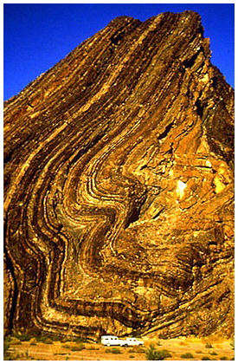

Slide 10

Stress and Strain
3) Brittle deformation (rupture)
  (Faulting)

Slide 11
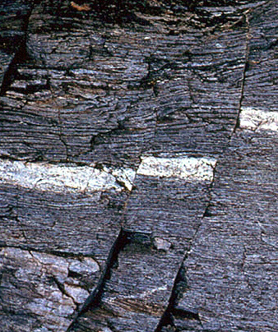

Slide 12
Stress and Strain
Factors that affect deformation
  Temperature
  Pressure
  Strain rate
  Rock Type
Will it fault or fold?

Slide 13
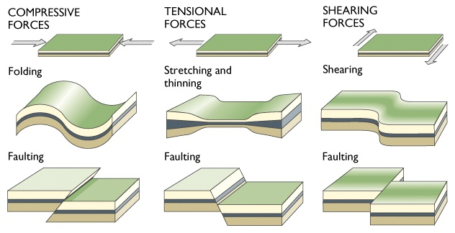
Matching activity
1 | 2 | 3
4 | 5 | 6
Elastic
Brittle

Slide 14
Tectonic Forces and Resulting Deformation

