Slide 1
Review items

Slide 2
Generalizations
What comes to mind?
Categorization vs. Generalization
Biology
Species, Genus, Family, Order,….
DNA Darwin 1st to understand the underlying mechanisms to heredity

Slide 3
Biology
Lots of work on classifying and understanding where and how different plants and animals lived.
After Mendel a switch from studying types of organisms to understanding the chemical basis of life.
Understanding life: “young science” DNA discovered in 1950’s
Tremendous personal satisfaction helping humans
Ethical concerns

Slide 4
Seismologists
Young science: Plate tectonics 1960’s
Geologic time is extremely hard to envision. Rocks move 1 inch per year. We have ~150 years of data on earthquakes.
Work in the field
Can only drill 10 miles into earth ~4000 miles deep
Use sound waves to study the earth.
Monitor earth’s activity (including nuclear activity)

Slide 5
Becoming a Scientist
What kind of kid can become a scientist?

Slide 6
Becoming a Scientist
Expertise
10,000 hours of deliberate practice
Coaching
Opportunity
Motivation
Growth Mindset

Slide 7
Derry Pathways
Serendipity and Methodical Work,
Detailed Background and Dreamlike Vision,
Idealized models and Mathematical Calculations,
Exploration and Observation, the Hypothetico deductive method

Slide 8
Which scientist's masterpiece discussed by Derry in Ch 1 is now considered obsolete?
None - the work of all 5 is still used to understand nature today.
All of them are out dated at this time.
Edward Jenner
Alexander von Humboldt
August Kekule

Slide 9
Which of the routes to discovery discussed by Derry is best described by the well known scientific method.
Exploration and observation
The hypothetico-deductive method
Idealized models and mathematical calculations
Serendipity and methodical work
Detailed background and dreamlike vision
All five routes to discovery emply the scientific method

Slide 10
How would Roentgen's discovery of X-Rays be best described?
Attention to experimental procedure
A combination of skill, keen observation, and experimental prowess.
The invention of electrons
Detailed background and dreamlike vision

Slide 11
While Jenner was working on the smallpox vaccine, how long did he conduct observations before he was able to distill his first hypothesis?
He began with a hypothesis
A few days
25 weeks
5 years

Slide 12
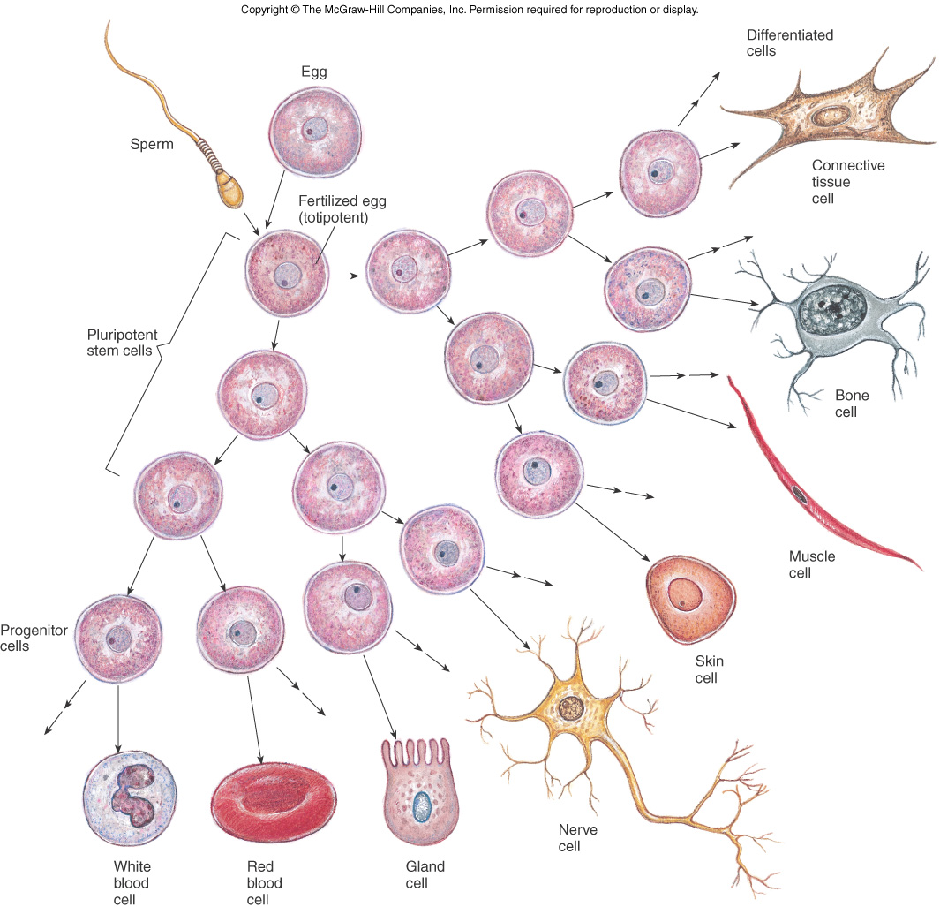
What is a stem cell?

Slide 13
What is a stem cell?

Slide 14
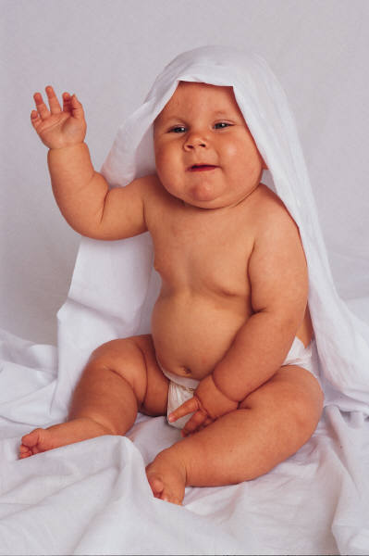
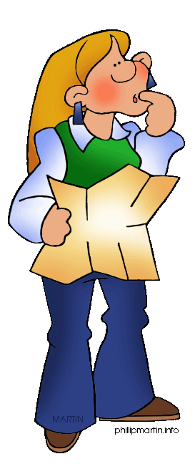
Stem Cells
Undifferentiated cells that contain all of our genetic information
Not just in the umbilical cord
complete directions to build a person (or frog or…).
Bone marrow (to make blood)
Testes (to make sperm)
Embryo (first two weeks)
Umbilical cord
Various other areas in body

Slide 15
Are eggs and sperm stem cells?
A. Yes
B. No

Slide 16
Are eggs and sperm stem cells?
A. Yes
B. No

Slide 17
What is a stem cell?

Slide 18
Mitosis vs. Meiosis

