Slide 1
Review items

Slide 2
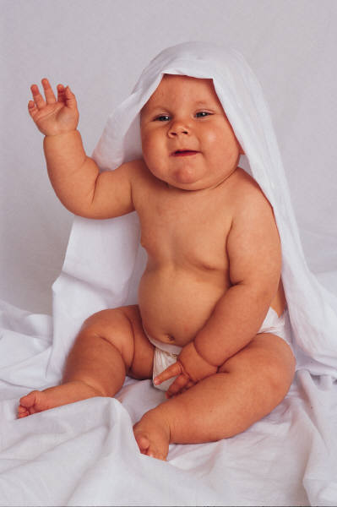
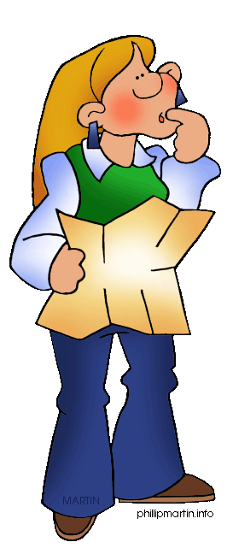
Stem Cells
Cells that contain all of our genetic information –
Not just in the umbilical cord
complete directions to build a person (or frog or…).
Bone marrow (to make blood)
Testes (to make sperm)
Embryo (first two weeks)
Umbilical cord
Various other areas in body

Slide 3
Questions
Are eggs and sperm stem cells?
Another?

Slide 4
What is a stem cell?

Slide 5
Sciences
Seismologists
Young science: Plate tectonics 1960’s
Geologic time is extremely hard to invision. Rocks move 1 inch per year. We have ~150 years of data on earthquakes.
Work in the field
Can only drill 10 miles into earth ~4000 miles deep
Use sound waves to study the earth.
Monitor earth’s activity (including nuclear activity)

Slide 6
Mitosis vs. Meiosis

Slide 7
Who undergoes mitosis?
Humans
Animals
Plants
A & B only
All of the above

Slide 8
Who undergoes meiosis?
Humans
Animals
Plants
A & B only
All of the above

Slide 9
Sciences
Biologists
Lots of work on classifying and understanding where and how different plants and animals lived.
After Mendel a switch from studying types of organisms to understanding the chemical basis of life.
Understanding life: “young science” DNA discovered in 1950’s
Tremendous personal satisfaction helping humans
Ethical concerns

Slide 10
Sciences
Science 465 - Unit on musical instruments
Compared and contrasted individual instruments
Generalized the basics of why they work

