Slide 1
Review items

Slide 2
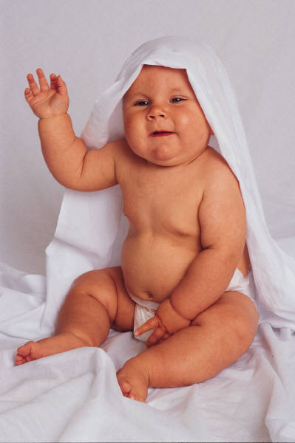
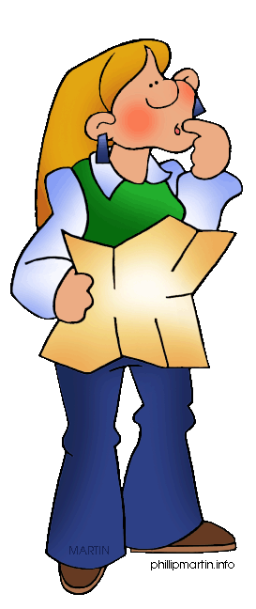
Stem Cells
Cells that contain all of our genetic information –
Not just in the umbilical cord
complete directions to build a person (or frog or…).
Bone marrow (to make blood)
Testes (to make sperm)
Embryo (first two weeks)
Umbilical cord
Various other areas in body

Slide 3
Questions
Are eggs and sperm stem cells?
Another?

Slide 4
What is a stem cell?

Slide 5
In Vitro Fertilization (IVF)
Super-ovulation is induced in mother to be
Multiple eggs removed
Combined with sperm in the lab

Slide 6
Early development
Fertilized and grown in the lab
Drugs help lots of eggs mature
Surgically remove ~30
Figure 3.14

Slide 7
In Vitro Fertilization (IVF)
Super-ovulation is induced in mother to be
Multiple eggs removed
Combined with sperm
Rate the health of each embryo
Flash frozen while testing and waiting for mom

Slide 8
Cell Removal

Slide 9
Testing
Now do all 23 chromosomes
Missing pieces or too much information
BUT – not every trait!!
Certain diseases and gender

Slide 10
In Vitro Fertilization (IVF)
Super-ovulation is induced in mother to be
Multiple eggs removed
Combined with sperm
Rate the health of each embryo
Flash frozen while testing and waiting for mom
Fertilized embryos/blastocysts are implanted in uterus
Extra embryos remain frozen

Slide 11
Brecken and Kaiya both had 8-1 =7 cells while embryos. Flash frozen and stored for several weeks. 2 others still frozen.

Slide 13
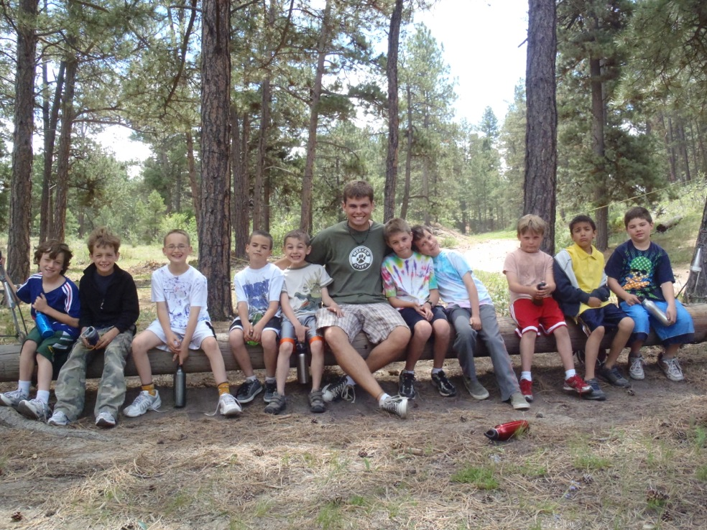
Devon knows Adam

Slide 14
Sciences
Seismologists
Young science: Plate tectonics 1960’s
Geologic time is extremely hard to invision. Rocks move 1 inch per year. We have ~150 years of data on earthquakes.
Work in the field
Can only drill 10 miles into earth ~4000 miles deep
Use sound waves to study the earth.
Monitor earth’s activity (including nuclear activity)

Slide 15
Sciences
Biologists
Lots of work on classifying and understanding where and how different plants and animals lived.
After Mendel a switch from studying types of organisms to understanding the chemical basis of life.
Understanding life: “young science” DNA discovered in 1950’s
Tremendous personal satisfaction helping humans
Ethical concerns

Slide 16
Sciences
Science 465 - Unit on musical instruments
Compared and contrasted individual instruments
Generalized the basics of why they work

