Slide 1
Gamete development and embryo development

Slide 2
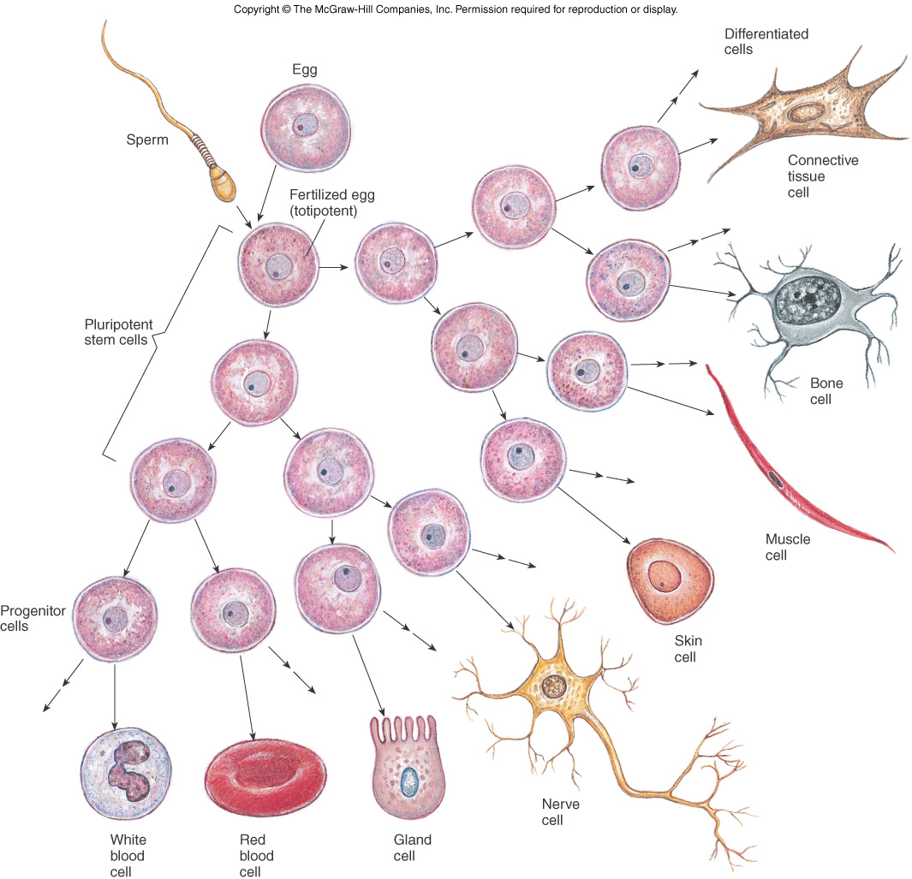
What is a stem cell?

Slide 3
What is a stem cell?

Slide 4
What is a stem cell?

Slide 5
What is a stem cell?

Slide 6
What is a stem cell?
Keep undergoing mitosis until something (hormones or other chemical tells them)

Slide 7
What is a stem cell?

Slide 8
What is a stem cell?

Slide 9
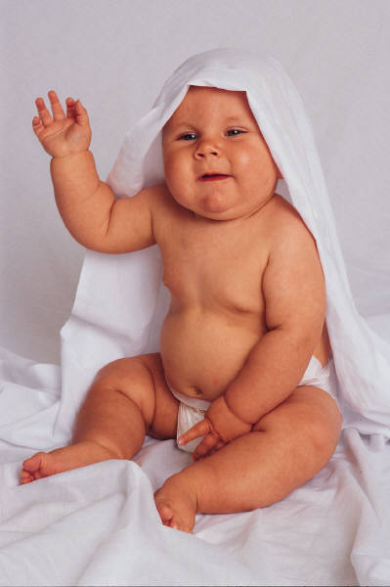
Stem Cells
Cells that contain all of our genetic information –
Not just in the umbilical cord
complete directions to build a person (or frog or…).
Bone marrow (to make blood)
Testes (to make sperm)
Embryo (first two weeks)
Umbilical cord
Various other areas in body

Slide 10
Are eggs and sperm stem cells?
A. No
B. Yes
Notes:
No Only the egg/sperm combination after fertilization. Then you have all the material needed to make a baby. Until then, each only has half.

Slide 11
What is a stem cell?

Slide 12
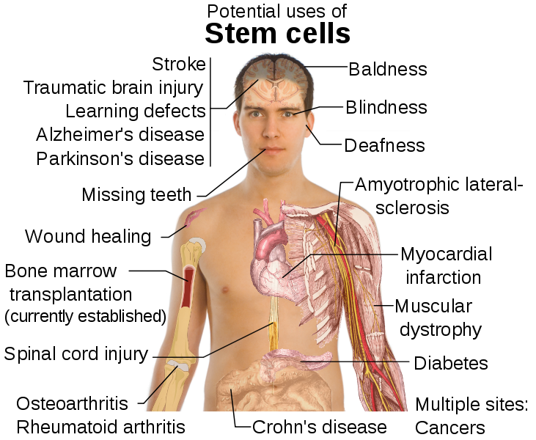
Stem cell “lines” can be maintained by taking cells from embryos and let them divide in a culture condition that allows them to keep dividing without forming any tissue.
At present, no new stem cell lines can be created using government money.

Slide 13
Oogenesis
First polar body
may divide
(haploid)
a
X
Polar
bodies
die
a
X
a
a
X
X
Mitosis
Meiosis I
Meiosis II
A
X
(if fertilization
occurs)
Oogonium
(diploid)
A
Primary
oocyte
(diploid)
X
A
X
Ovum (egg)
Mature
egg
Secondary
oocyte
(haploid)
A
X
Second
polar body
(haploid)

Slide 14
Oogenesis Spermatogenesis
Eggs are created in the embryo, before birth
These eggs begin meiosis (before birth) and stop just before the first division.
Puberty: ovulation once a month, egg completes it’s first division and is released from the ovary
It begins the second division, but does not complete the process unless fertilized!
On average, a woman will ovulate about 400 eggs between puberty and menopause.
Stem cells that will make sperm are present at birth
Puberty: the stem cells undergo mitosis to make spermatocytes
Proceed immediately into meiosis and produce spermatids that mature into sperm – 48 day cycle.
Each orgasm produces about 400 million sperm cells.

Slide 15
Fertilization
As soon as one sperm gets into the egg, a chemical reaction occurs, preventing additional sperm from entering.

Slide 16
What would happen if two sperm fertilized the egg?
Embryo would develop normally
Embryo would die
This is the process that creates fraternal twins
Notes:
E Embryo would get 3 copies of every chromosome (2 from 2 sperm and 1 from the egg) and that would cause it to die.

Slide 17
What would happen if two sperm fertilized the egg?
Embryo would have 3 copies of every chromosome
Embryo would have normal chromosomal content
Either a or b.
Notes:
E Embryo would get 3 copies of every chromosome (2 from 2 sperm and 1 from the egg) and that would cause it to die.

Slide 18
Twins
Fraternal
Two separate eggs ovulated.
Just like any other siblings.
Identical
A fertilized egg splits into two.
Share exact genetic material

Slide 19
Reproductive problems and technology 40% caused by male, 40% by female, 20% complications with both Male infertility About 1 in 25 men are infertile (4%) (usually a problem with Y chromosome genes)
About one in 25 men are infertile (4%) (usually a problem with Y chromosome genes)
Female infertility: more things can go wrong
failure to ovulate
cystic ovaries
failure of uterine lining to thicken
abnormal thickening of lining (endometriosis)
blocked Falopian tube
failure of implantation, etc.

Slide 20
Defects during development can be caused by
recessive disease that both parents carry (Molly’s case)
complete loss or duplication of a chromosome
can have pieces rearranged
can trade material

Slide 21
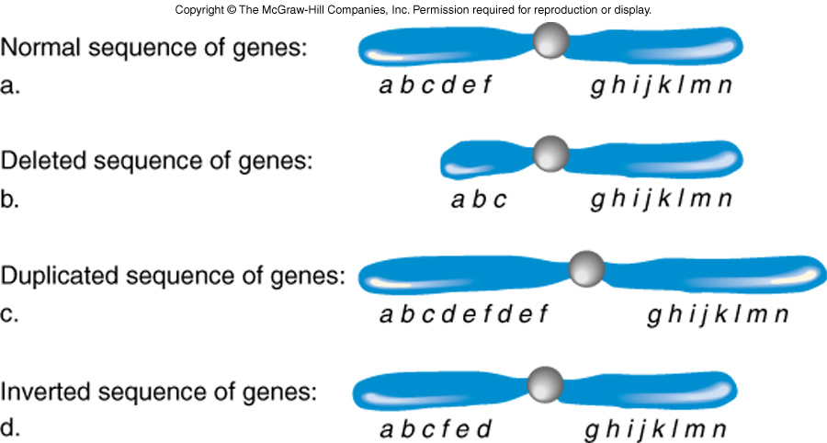
Abnormal chromosome structure

Slide 22
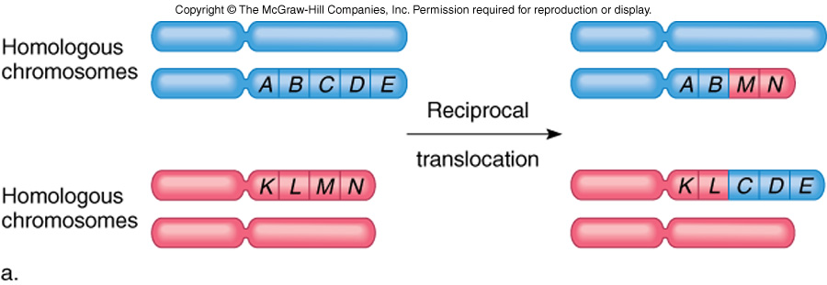
Translocations
All parts of all chromosomes are present so person is usually normal.
Problems arise if a gene is interrupted
Next generation can be affected

Slide 23
Miscarriage Our body’s way of taking care of most chromosomal defects – “mistakes”.
25 - 30% of all pregnancies - usually in first 6 weeks
60% of early miscarriages are genetic problems
Rate of miscarriage increases with age of both men and women.
3 or more in a row considered a case for further investigation.

Slide 24
In Vitro Fertilization (IVF)
Super-ovulation is induced in mother to be
Multiple eggs removed
Combined with sperm in the lab

Slide 25
Early development
Fertilized and grown in the lab
Drugs help lots of eggs mature
Surgically remove ~30
Figure 3.14

Slide 26
In Vitro Fertilization (IVF)
Super-ovulation is induced in mother to be
Multiple eggs removed
Combined with sperm
Rate the health of each embryo
Flash frozen while testing and waiting for mom

Slide 27
Pre-implantation Genetic Screening or Diagnosis (PGS or PGD)
Detection of genetic abnormalities prior to implantation.
PGS – checks for number of chromosomes
PGD – checks for specific diseases like cystic fibrosis (can also tell gender)
Since June 2008 can screen all 23 chromosomes
Time consuming so flash freeze embryos
Gives mom time to recover from egg harvesting.

Slide 28
Cell Removal
What do you think happens to the embryo that has only 7 instead of 8 cells now?
It will develop abnormally
It will not develop at all
It will develop normally
They put the 8th cell back after testing.
Notes:
C The cells are still stem cells so the 7 have all the same information as the 8th that was removed. This means nothing goes wrong without it.

Slide 29
In Vitro Fertilization (IVF)
Super-ovulation is induced in mother to be
Multiple eggs removed
Combined with sperm
Rate the health of each embryo
Flash frozen while testing and waiting for mom
Fertilized embryos/blastocysts are implanted in uterus
If 2 embryos implanted: have a 50-60% of 1 surviving and 30% that both will survive
Extra embryos remain frozen

Slide 30
Brecken and Kaiya both had 8-1 =7 cells while embryos. Flash frozen and stored for several weeks. 2 others still frozen.

Slide 31
Notes:
Kaiya and Brecken my IVF neice and nephew

Slide 33
Early development: ovulation to implantation
Figure 3.14

Slide 34
Blastocyst
The developing embryo becomes a hollow ball of cells and is called a blastocyst.
.
Some IVF clinics wait until blastocyst stage and remove the cell from the outer layer.

Slide 35
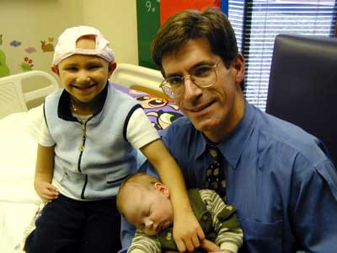
What was unusual (first of its kind) about the form of PGD (preimplantation genetic diagnosis) that was used with Molly’s brother Adam?
He was the first embryo where PGD was used to remove unwanted genetic characteristics.
He was the first embryo selected in a lab for his immune system so he could help Molly.
He was the first embryo where PGD was used to give Adam the specific genes needed to help Molly
Molly Nash, suffering from Fanconia Anemia
with brother Adam, whose stem cells saved her life, and Dr. Wagner.

Slide 36
What was unusual (first of its kind) about the form of PGD (preimplantation genetic diagnosis) that was used with Molly’s brother Adam?
He was the first embryo where PGD was used to remove unwanted genetic characteristics.
He was the first embryo selected in a lab for his immune system so he could help Molly.
He was the first embryo where PGD was used to give Adam the specific genes needed to help Molly
Notes:
B. Scientists at this point are not able to remove or give genetic characteristics to embryos of any kind. They don’t have the technology not to mention the ethical ramifications!!

Slide 37
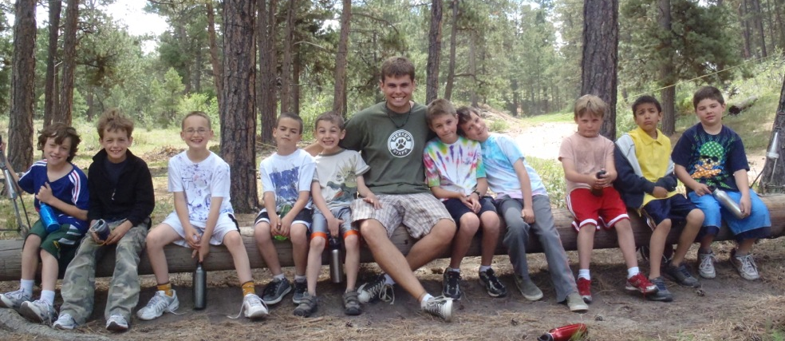
I was doing some more research on the article about [Molly}]. I didn't know where I heard this before; it sounded so familiar. I looked up the family and it turns out that Adam, the family's son, was my camper at the resident camp I work at in the summer. What a small world. In the picture, he is the child on the far left of me on the log.

Slide 38
How can Molly inherit Fanconi’s anemia even though neither of her parents suffer from the disease?
She didn’t inherit it, it was a random mutation that caused her to get it.
It must be a dominant trait and each of her parents were a carrier.
It must be a recessive trait and each of her parents were a carrier.
It must be a recessive trait and only one of her parents was a carrier.
It must be a dominant trait and only one of her parents was a carrier.

Slide 39
How can Molly inherit Fanconi’s anemia even though neither of her parents suffer from the disease?
She didn’t inherit it, it was a random mutation that caused her to get it.
It must be a dominant trait and each of her parents were a carrier.
It must be a recessive trait and each of her parents were a carrier.
It must be a recessive trait and only one of her parents was a carrier.
It must be a dominant trait and only one of her parents was a carrier.

Slide 40
What are the odds that the Nash’s next child would have the disease? Assuming a natural pregnancy – not IVF?
100
75
50
25
less than 1
1 in 4 or 25%

Slide 41
How much pain and suffering was involved for Adam when his cells were donated to Molly?
A substantial amount - bone marrow removal is very painful
Adam was only a baby so he was too young to suffer from the pain
A new technique was used that caused very little pain and suffering
None – his marrow was not used.

Slide 42
How much pain and suffering was involved for Adam when his cells were donated to Molly?
A substantial amount - bone marrow removal is very painful
Adam was only a baby so he was too young to suffer from the pain
A new technique was used that caused very little pain and suffering
None – his marrow was not used.
Cells from Adam’s umbilical-cord blood where used to seed Molly’s bone marrow.

Slide 43
“Spare” Embryos: ethical concerns
Fertilized embryos that are not implanted can be donated for research purposes
Stem cell “lines” can be maintained to help cure all sorts of diseases and ailments.
Using IVF and PGS or PGD, a prospective child can be “screened” to see if they are healthy, or even if they are a match for donating stem cells to a sibling.

