Slide 1
Partner activity
Do not peek!!
Notes:
Anatomy of a wave partner activity: One person is a reporter and the other is the artist. The artist tries to draw what the reporter describes. Rules are important but the result is kids learn the parts of a wave and they learn how hard it is to use only a verbal description!

Slide 2
wavelength
wavelength
Notes:
Define a wavelength as the length between adjacent crests. Show both the first two wavelengths on the slide.

Slide 3
Is this a wavelength?
Yes
No
Notes:
Ask the class if this is also a wavelength? It is.

Slide 4
Is this a wavelength?
Yes
No
Notes:
Ask the class if this is a wavelength. It is actually 2 wavelengths.

Slide 5
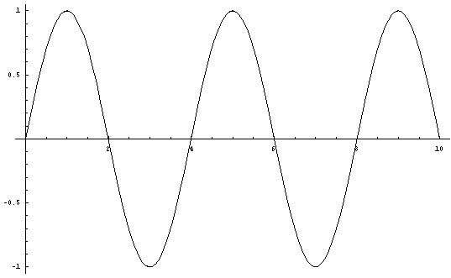
What is
Amplitude?
How high/low the crests/troughs are.
Frequency?
Rate of the wiggle
Notes:
Define amplitude then show the 1st wave. Ask students to describe what the same wave would look like with a smaller amplitude. If they’ve done the “Wave Basics” homework, they should be able to do this.
Next define frequency. Then show the wave and ask students what it would look like with a smaller frequency.

Slide 6
Waves travel
Do the wave
Did the wave make it across the room?
Did the people who started it move across the room?
People move up and down as the wave’s energy goes past.
Waves carry energy
Notes:
Have the class do the wave. Then show the animation and talk about wave travel. How the energy moves across the room but the people only move up and down. Describe the people as the “medium” that the wave moves through/on.

Slide 7
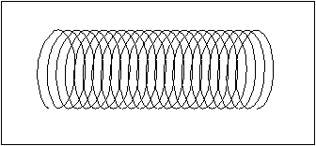
Types of Waves
Transverse Waves
Longitudinal Waves
Transverse, Longitudinal, and Periodic Waves
Notes:
The link at the bottom is a site that has very nice animations. However, it requires Apple Quicktime to run. These animations are simpler and easier to grasp than a slinky wave so I show the slinky after I show the animation.

Slide 8
Source, Receiver & Medium
People Wave
What is the Source?
first person
What is the Receiver?
last person
What is the Medium?
all the people
Notes:
Ask what the source, receiver and medium is for each of these types of waves. You can show the PhET Interactive Simulations “Wave Interference” simulation as a visual of water waves if desired.

Slide 9
Source, Receiver & Medium
Wave on a String
What is the Source?
Orange Pump
What is the Receiver?
Clamp
What is the Medium?
The string of red beads
Notes:
Ask what the source, receiver and medium is for each of these types of waves. You can show the PhET Interactive Simulations “Wave Interference” simulation as a visual of water waves if desired.

Slide 10
Source, Receiver & Medium
Longitudinal slinky wave
What is the Source?
start of slinky
What is the Receiver?
start of slinky
What is the Medium?
The slinky
Notes:
Ask what the source, receiver and medium is for each of these types of waves. You can show the PhET Interactive Simulations “Wave Interference” simulation as a visual of water waves if desired.

Slide 11
Source
http://www.iris.edu/hq/programs/education_and_outreach/videos#H
Notes:
I used this lesson to introduce earthquakes so showed video H on this page. Epicenters and focus. We talk about the source of the earthquake.

Slide 12
How do waves add?
Notes:
Use the PhET Wave on a String simulation: Phet.colorado.edu and asked how the waves add? Example on next slide. It helps to show the Wave on a String simulation first. Show one pulse and how it travels back and forth along the string. Then ask the question on the following slide. You could show both pulses shown on the next slide separately but not together or that will give it away!

Slide 13
Sketch what you think the pattern will look like
Notes:
After students draw their predictions, ask for them to share with the class. Then show the results on the simulation. Click the snapshot to open the sim.
To demonstrate: I used the Pulse feature with Zero damping. First I set the wave characteristics to A = 50, PW = 50, Damping = 0, Tension high, then pulsed and paused quickly. Then I reset the characteristics and sent another pulse. Quickly ,I paused again and used the Step feature for slow motion. You can cycle through the waves interactions many times by stepping.

Slide 14
Notes:
You can see that the lower wave is moving to the left. In shot 3 it’s under the top wave. So the top wave is shorter and the lower wave isn’t showing. When you add them up the top wave plus the negative bottom wave, you get a smaller but still positive number. On shot 4 you can see the lower wave emerge on the left and the top wave is bigger again. Finally shot 5 they are separate again and no different than they were to start with.

Slide 15
Resonance
The natural frequency of an object

Slide 16
Resonance
Swinging
http://www.youtube.com/watch?v=I4FPK1oKddQ
The frequency an object likes to vibrate at
Notes:
Watch the swing example and explain how your push has to be just right. If it is, each time you push it adds to how high the person is going. If you try to push with different timing than the swings Natural frequency, it just doesn’t work!
Show the pasta raisin demo.

Slide 17
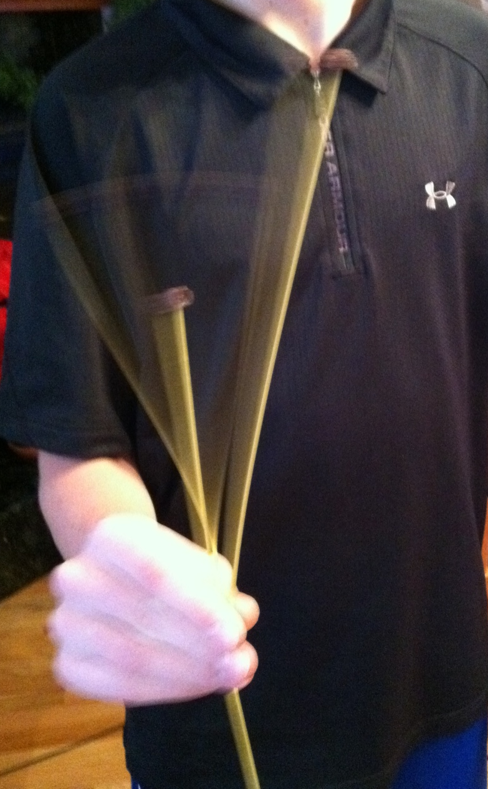
Resonance
Pasta/raisin demonstration
The frequency an object likes to vibrate at
Notes:
Show the pasta raisin demo. In this picture can you see the middle pasta and how fast it is moving?!

Slide 18
Resonance
The frequency an object likes to vibrate at
Wave on a String (A=3, f=50, Damp = 0, Tension = high)
Notes:
Use the settings given above to show resonance with the Wave on a String simulation. It’s really NEAT.

Slide 19
Resonance
The frequency an object likes to vibrate at
Tall vs. Short Building damage
http://www.iris.edu/hq/programs/education_and_outreach/videos#O
Notes:
This is a very clear video of resonance. It’s designed to demonstrate earthquake damage but works beautifully for resonance in general. It shows different height objects resonating at different frequencies. I stop the video at the points where the speaker says he asks his students to predict, then I ask my students to predict.

